Slide 1




MSc Data Science AUEB Data Visualization and Communication Professors: Dimitris Karlis, Nikos Platis Giagkos Stylianos | f3352410 Papadopoulos Ioannis | f3352409 Vitsentzatos Nikolaos | f3352405
“France on the Road: A Nation in Motion”
Insights from Road Accidents (2009–2012)
An Evidence-Based Exploration of Risk, Behavior, and Road Safety
Notes:
STELIOS

Slide 2
Introduction
France on the Road: A Nation in Motion
Insights from Road Accidents (2009–2012)
Notes:
STELIOS

Slide 3

Introduction
Why Road Accident Data Matters
A national-scale analysis of injury-causing road accidents, leveraging open government data:
Based on: Annual French Road Accident Database (BAAC)
Collected by: French Ministry of the Interior (2005–2023)
Covers: Thousands of incidents annually involving multiple actors, locations, and risk factors
Purpose: Inform public safety policy, urban planning, and awareness campaigns through data-driven insights
France on the Road: A Nation in Motion
Insights from Road Accidents (2009–2012)

Slide 4
Introduction
What This Study Examines
France’s accident patterns through the lens of:
Time & Seasonality (day, hour, month, holidays)
Geography & Infrastructure (road type, urban/rural, collisions)
Demographics (age, gender, vehicle type, travel purpose)
Severity & Safety Behavior (injury outcomes, seatbelt/helmet use)
France on the Road: A Nation in Motion
Insights from Road Accidents (2009–2012)

Slide 5
Temporal Patterns
When do accidents happen?
France on the Road: A Nation in Motion
Insights from Road Accidents (2009–2012)
Notes:
STELIOS

Slide 6
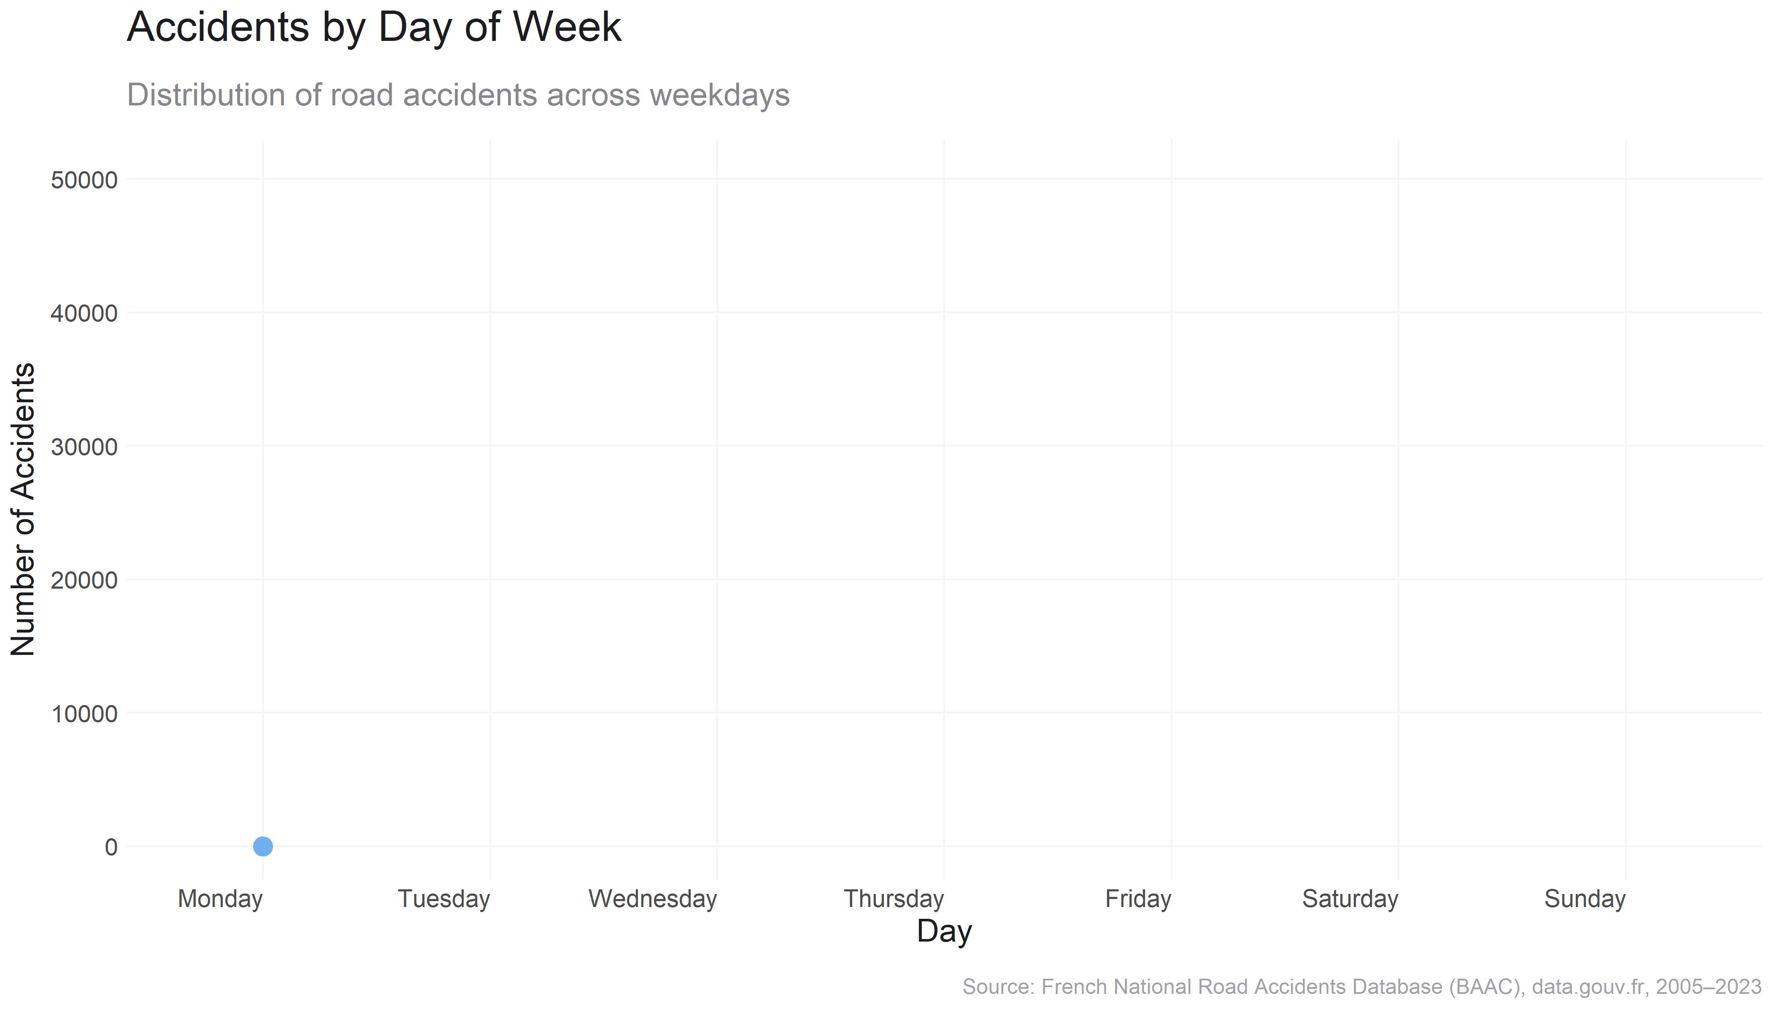
Temporal Patterns
When do accidents happen?
“ Accidents are most frequent on Fridays and consistently high on weekdays. ”
Fridays experience the highest accident counts, with weekdays generally showing more incidents than Sundays.
Fridays have the highest number of recorded accidents, peaking above 40,000.
A consistent pattern emerges: Monday to Saturday all have significantly higher accident volumes than Sunday.
Sunday stands out with the lowest count, suggesting reduced traffic or more cautious behavior.
France on the Road: A Nation in Motion
Insights from Road Accidents (2009–2012)

Slide 7
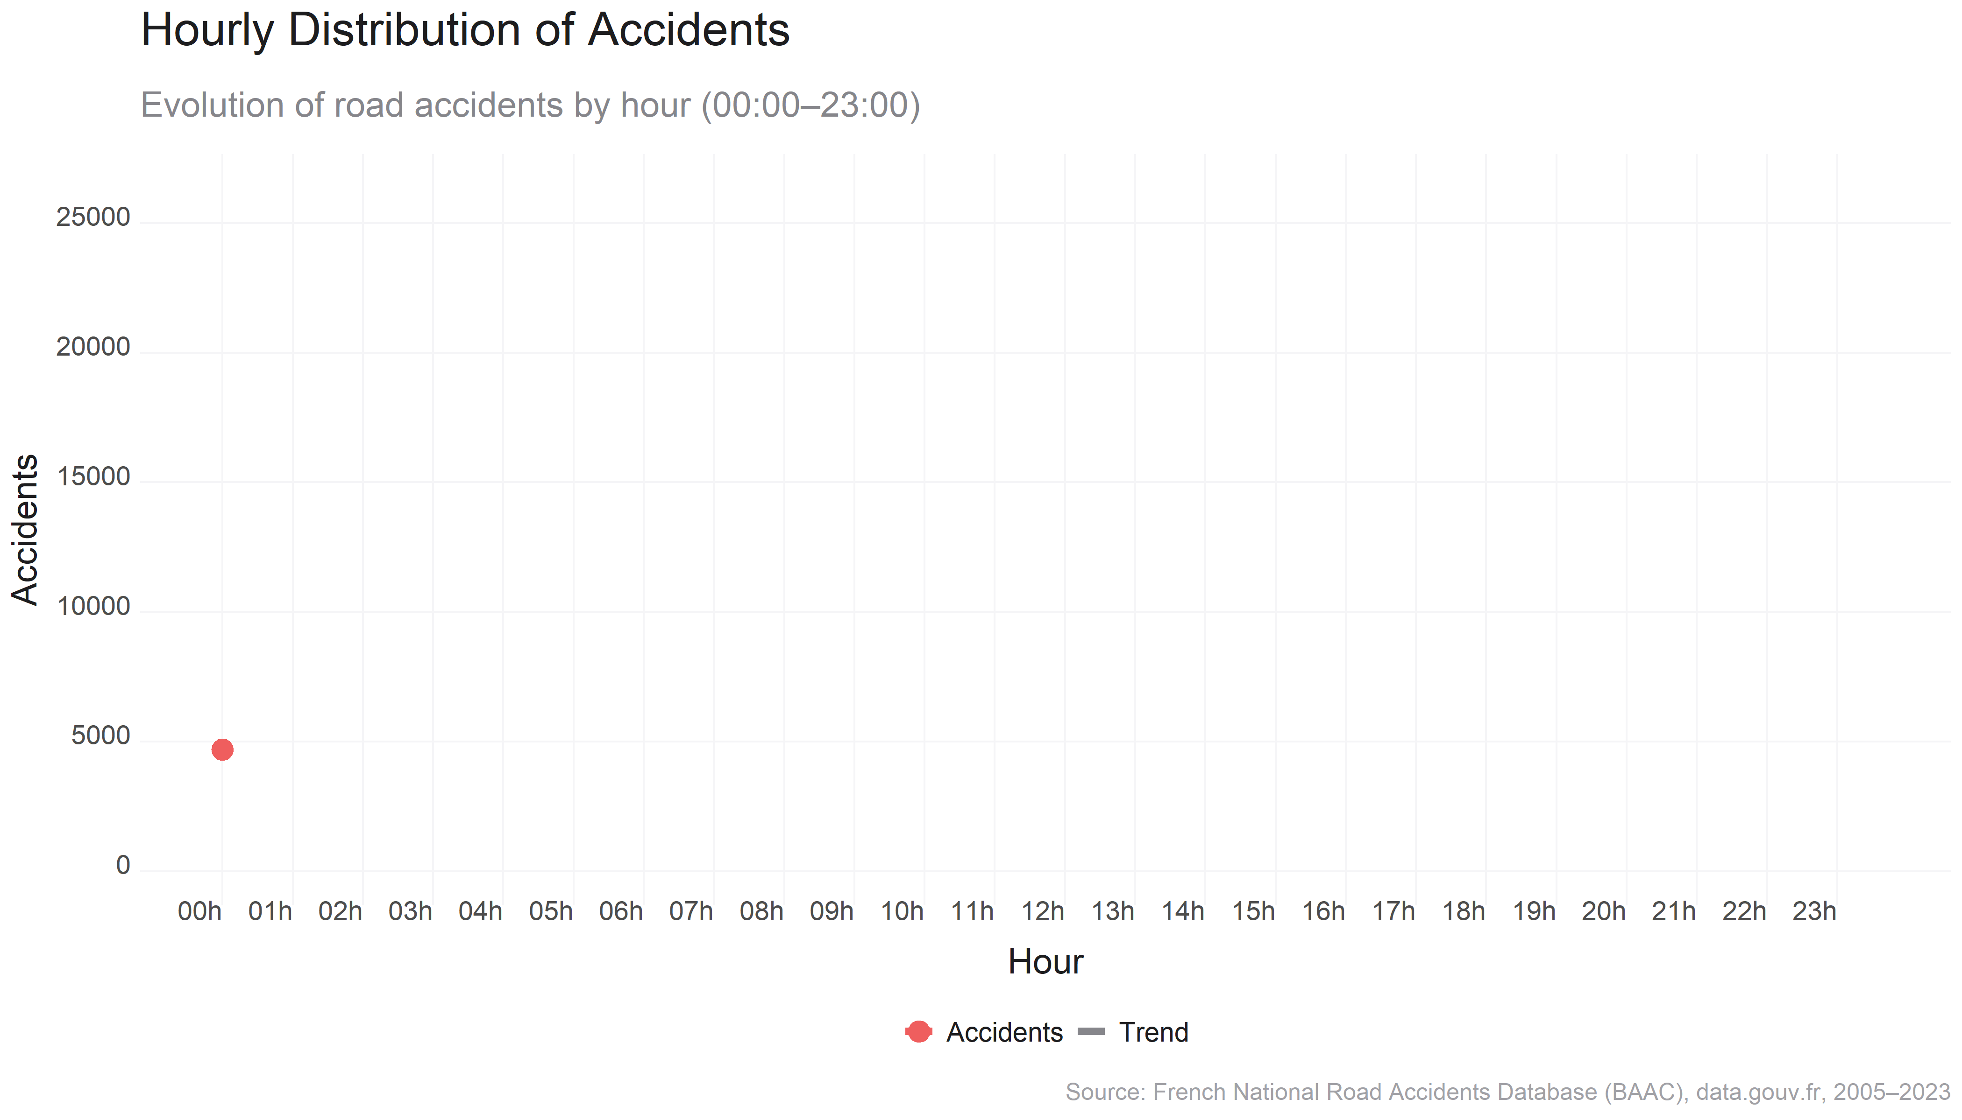
Temporal Patterns
When do accidents happen?
“Accidents spike sharply during evening rush hours, especially between 17:00–19:00.”
Road accidents increase steadily throughout the day and peak in the early evening hours, highlighting commuting risk.
The lowest accident counts are recorded in the early morning hours (03:00–05:00), likely due to minimal traffic.
Starting at 07:00, accident frequency climbs steadily, with a small peak at 08:00, likely reflecting the morning commute.
The most critical period is 17:00–19:00, which coincides with evening rush hour — where the sharpest and highest peak occurs.
After 20:00, the frequency drops off rapidly.
The dashed trend line confirms this pattern.
France on the Road: A Nation in Motion
Insights from Road Accidents (2009–2012)

Slide 8
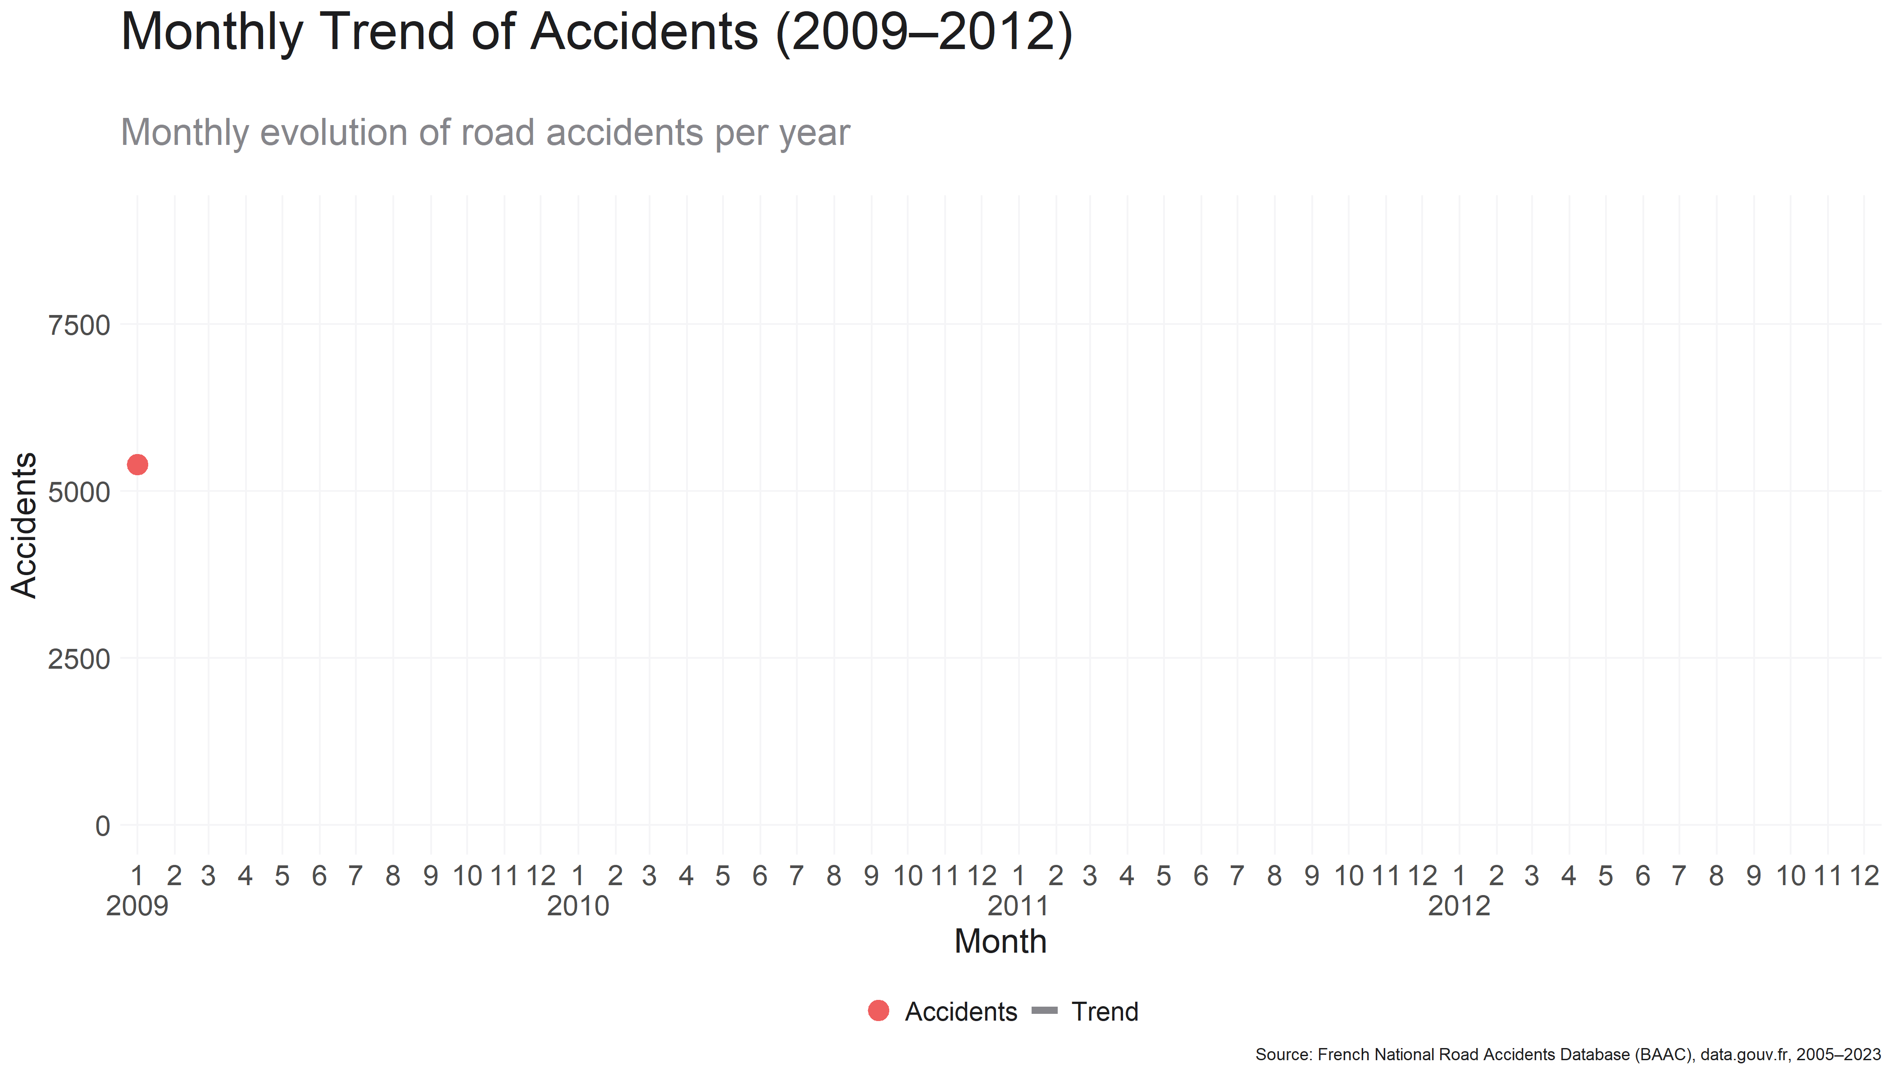
Temporal Patterns
When do accidents happen?
“Accidents show recurring seasonal peaks, especially in late spring
(May–June) and early autumn (October).
Between 2009 and 2012, accident peaks consistently occurred in May–June and October, suggesting seasonal risk cycles tied to commuting patterns, weather shifts, and holiday transitions.
All four years highlight monthly peaks in either September or October, with October emerging as the most frequent danger point.
These spikes are likely tied to:
Back-to-school and work commutes resuming
Worsening weather conditions and reduced daylight
Increased congestion after holiday periods
The dashed loess trend line indicates a gradual decline in accident volume over the 4-year period.
These observations reinforce the value of seasonal safety campaigns and road preparedness before autumn.
France on the Road: A Nation in Motion
Insights from Road Accidents (2009–2012)

Slide 9
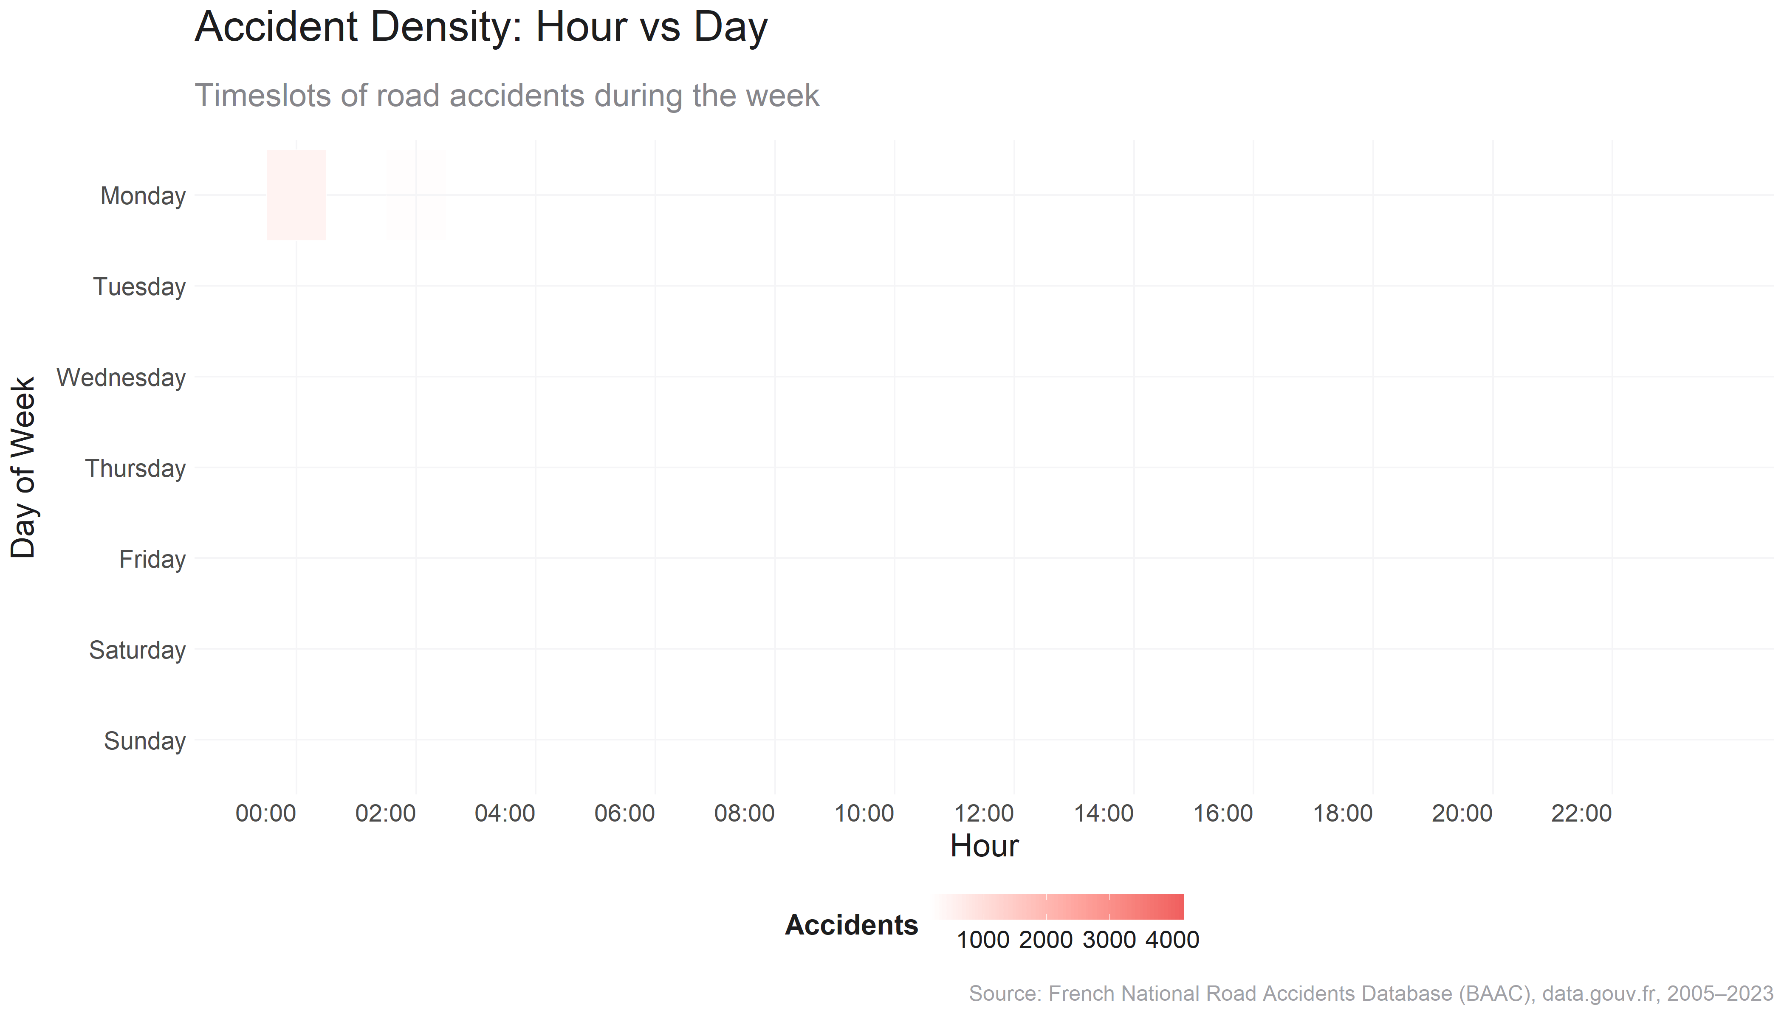
Temporal Patterns
When do accidents happen?
“Accidents concentrate during weekday rush hours, especially Fridays at 17:00–19:00, and shift to late-night/early-morning hours during weekends.
Accident density peaks sharply during late afternoon commute hours on weekdays, particularly Fridays, while weekends show broader, lower-intensity accident distributions.
Weekday Trends:
Strongest concentration of accidents from 08:00–10:00 and 16:00–19:00.
Friday evening (17:00–19:00) stands out as the most accident-prone slot of the week.
Weekend Trends:
Saturday and Sunday show wider accident distributions across the day.
Moderate density continues into late night and early morning, possibly reflecting nightlife-related risks.
France on the Road: A Nation in Motion
Insights from Road Accidents (2009–2012)

Slide 10
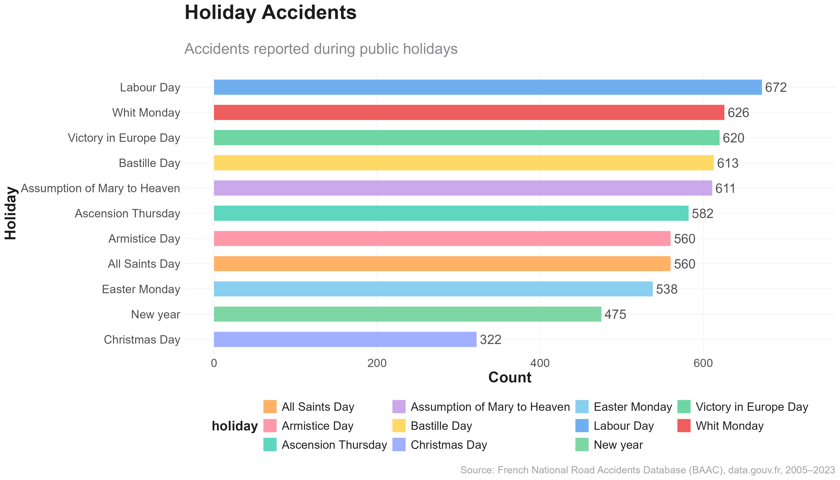
Temporal Patterns
When do accidents happen?
“Certain public holidays—particularly in spring and early summer—are linked to higher accident counts.”
Labour Day, Whit Monday, and Victory in Europe Day see the highest number of reported road accidents among national holidays.
Labour Day (672), Whit Monday (626), and Victory in Europe Day (620) top the list.
Spring and early summer holidays tend to show higher accident numbers, likely due to:
Increased travel and leisure outings.
Longer daylight hours leading to more active road usage.
Holidays like Christmas (322) and New Year (475) have noticeably lower accident counts, possibly due to:
Reduced travel.
Heavier enforcement or public messaging during winter holidays.
France on the Road: A Nation in Motion
Insights from Road Accidents (2009–2012)

Slide 11
Geographic & Infrastructure Risk
Where do accidents happen — and under what physical conditions?
France on the Road: A Nation in Motion
Insights from Road Accidents (2009–2012)
Notes:
GIANNIS

Slide 12
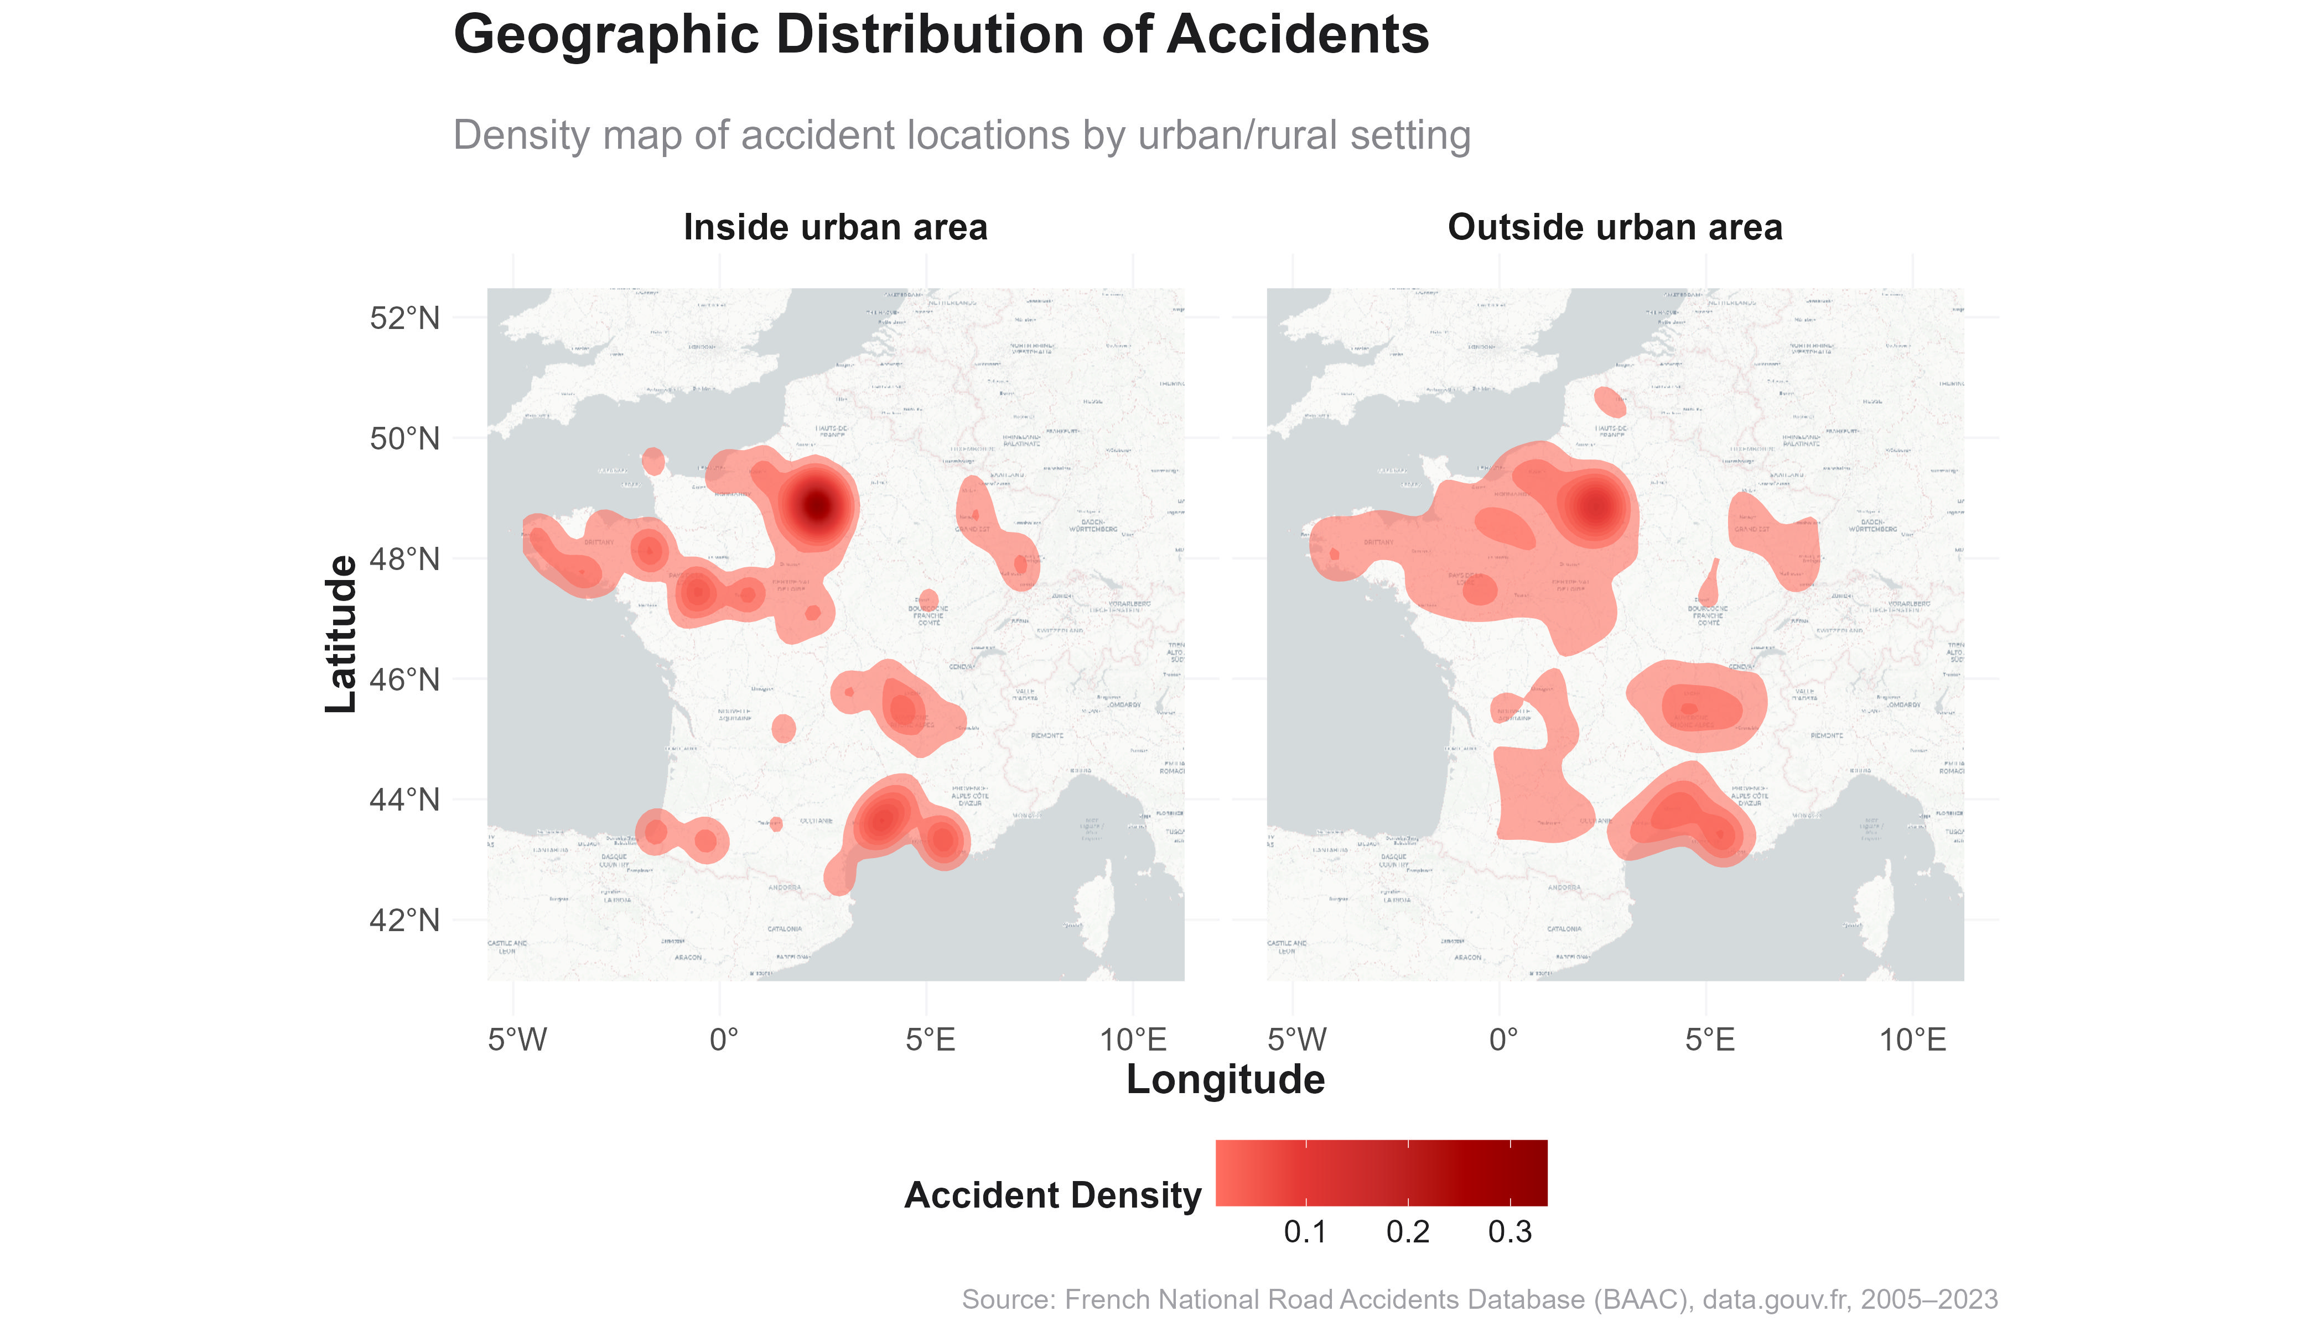
Geographic & Infrastructure Risk
Where do accidents happen — and under what physical conditions?
“Urban areas show higher accident concentrations, while rural areas reveal broader but sparser clusters.”
Urban accidents cluster around major cities; rural incidents are more spread out, particularly in central and southeastern France.
Urban Zones:
High concentration around Île-de-France (Paris region), Lyon, Marseille, and Bordeaux.
Reflects dense traffic, pedestrian activity, and urban congestion.
Rural Zones:
Accidents are more geographically dispersed, particularly in central, eastern, and southern France.
These often occur on departmental or national roads with higher speed limits and lower visibility.
France on the Road: A Nation in Motion
Insights from Road Accidents (2009–2012)

Slide 13
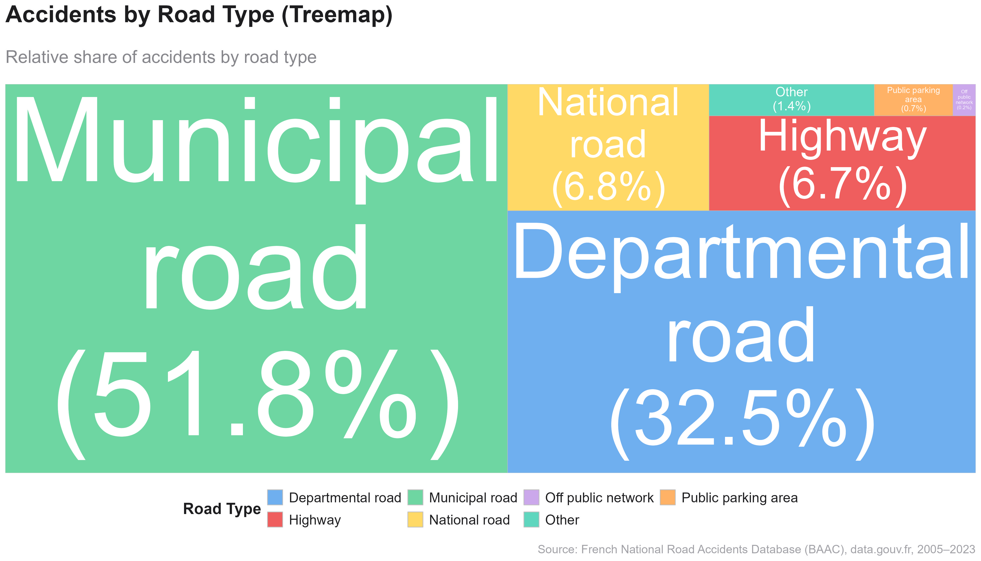
Geographic & Infrastructure Risk
Where do accidents happen — and under what physical conditions?
“Municipal and departmental roads account for nearly 80% of all road accidents.”
Municipal (51.8%) and departmental (32.5%) roads dominate the accident landscape in France.
Municipal roads: nearly half of all incidents (51.8%) — these are local roads with dense traffic and varied users
Departmental roads: 32.5%, representing interregional connections
National roads and Highways:
~ 7% for both, despite higher speeds — suggesting better design or policing
Minor shares: Parking lots and off-network locations
France on the Road: A Nation in Motion
Insights from Road Accidents (2009–2012)

Slide 14
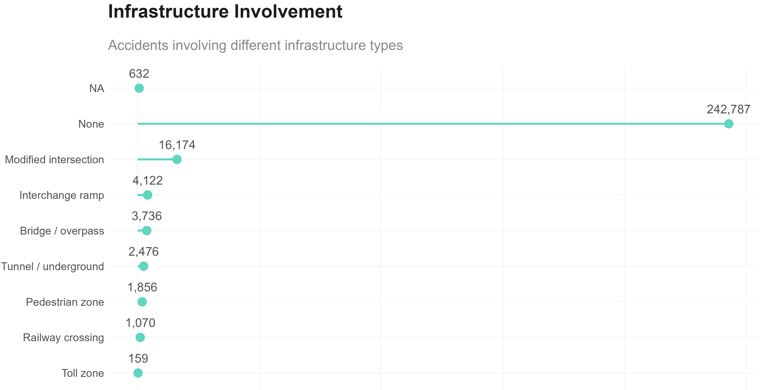
Geographic & Infrastructure Risk
Where do accidents happen — and under what physical conditions?
“Most accidents occur outside specialized infrastructure, but intersections and ramps remain high-risk locations.”
The majority of accidents did not involve special infrastructure, yet intersections and ramps account for a significant portion of those that did.
No Infrastructure Involvement:
Over 240,000 accidents occurred on regular roads without special features.
High-Risk Structures:
Modified intersections are the top infrastructure-related setting, with over 16,000 incidents, likely due to complex navigation, signaling issues, or blind spots.
Interchange ramps (4,122) and bridges/overpasses (3,736) also present notable risk due to merging complexity and speed variation.
Other Observations:
Pedestrian zones, tunnels, and railway crossings
France on the Road: A Nation in Motion
Insights from Road Accidents (2009–2012)

Slide 15
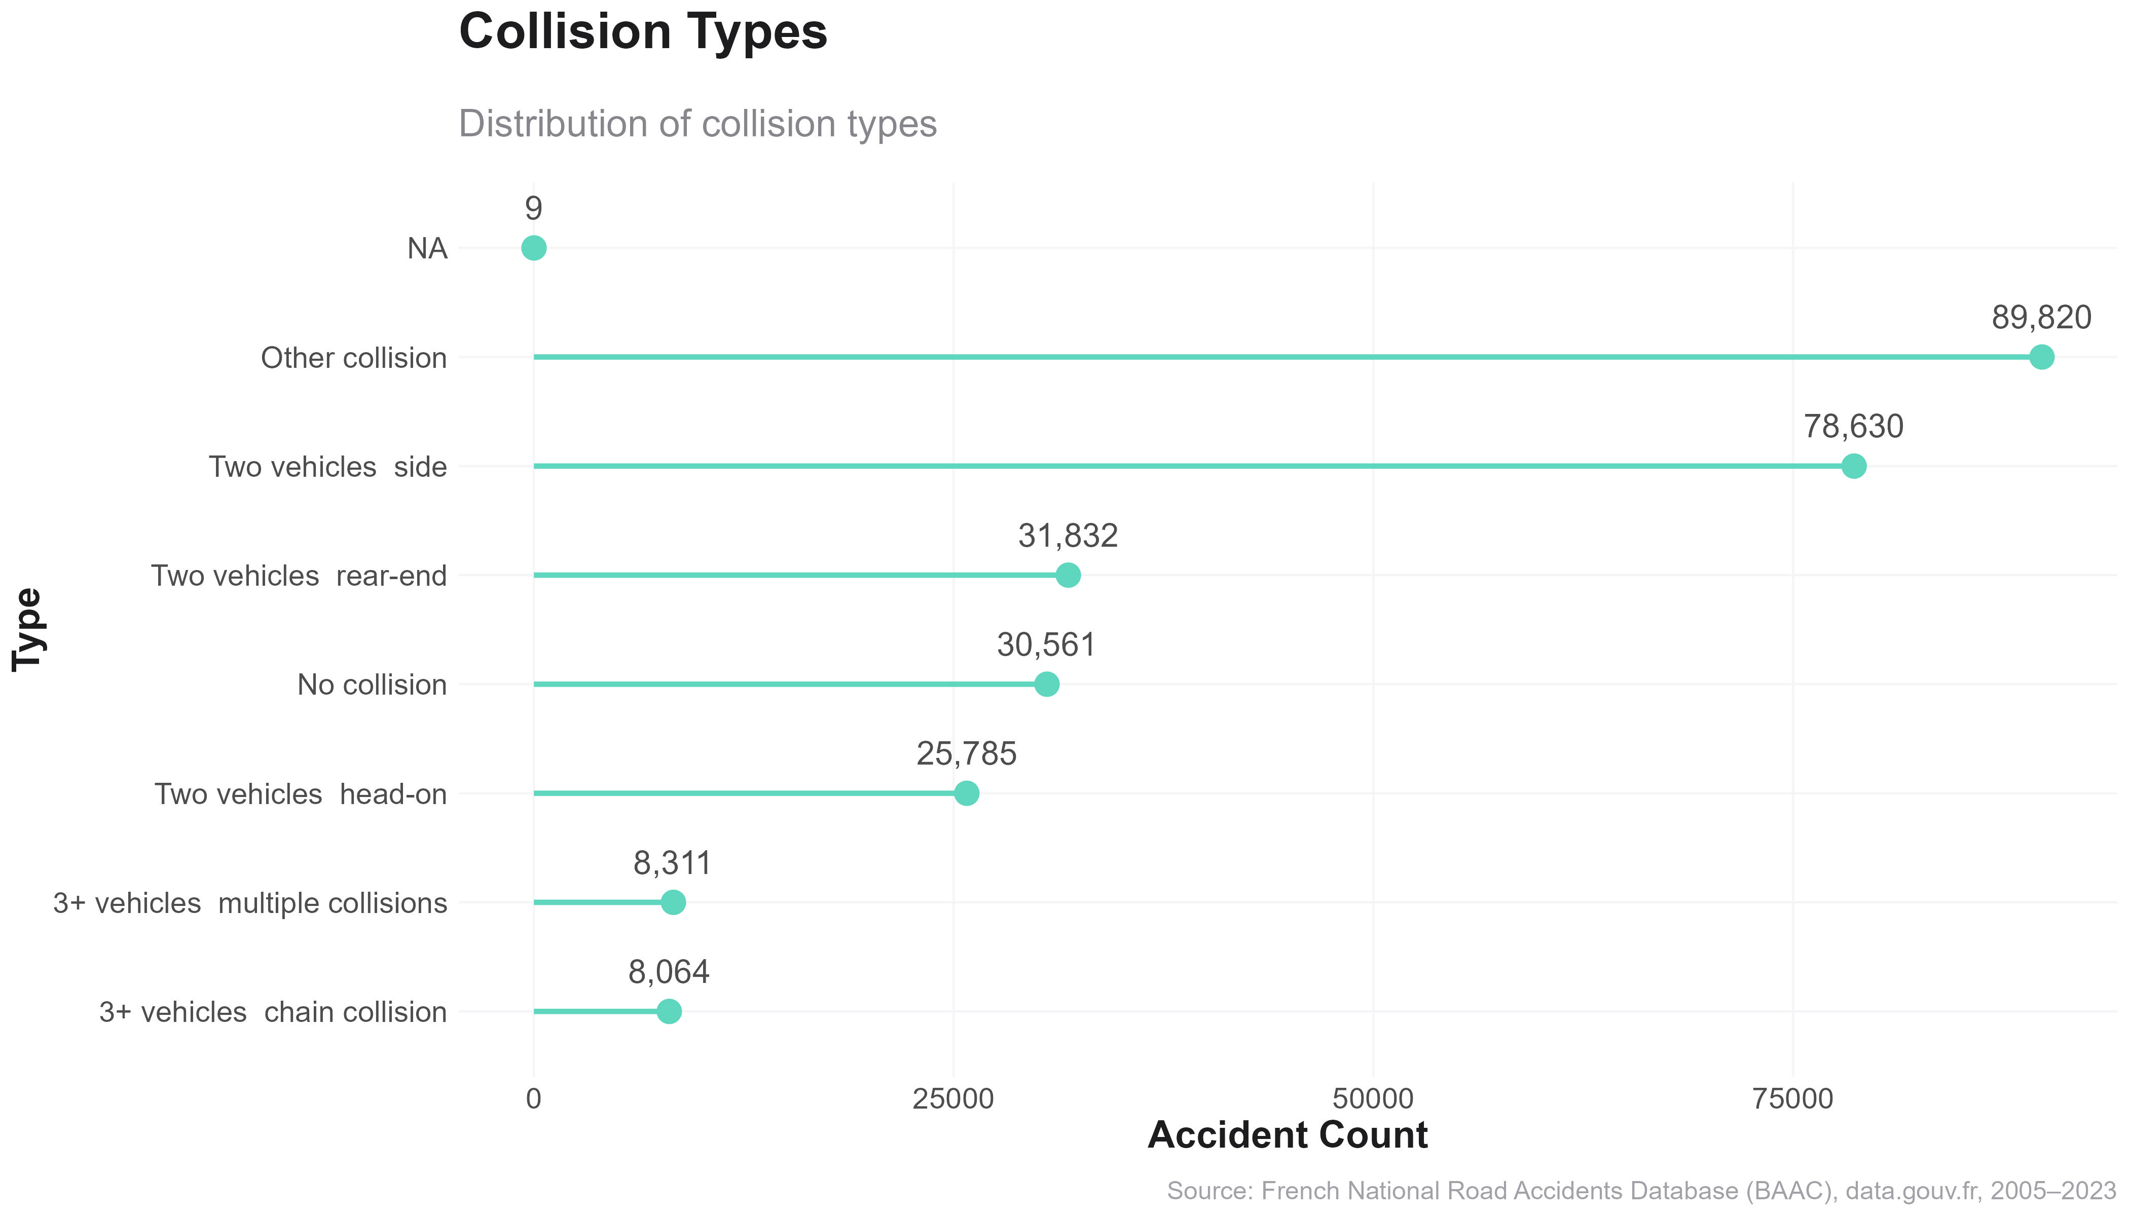
Geographic & Infrastructure Risk
Where do accidents happen — and under what physical conditions?
“Side and rear-end collisions are the most common crash types, but varied collision scenarios demand diverse safety interventions.
Most accidents involve side or rear-end collisions, reflecting common driving dynamics in traffic and urban settings.
Dominant Types:
Other collisions (89,820) lead in total count, indicating scenarios that don’t neatly fall into common crash patterns
Side collisions (78,630) and rear-end crashes (30,561) are the next most frequent, often occurring at intersections, during lane changes, or in traffic congestion.
Less Frequent but Riskier:
Head-on collisions (25,785) are less common but tend to result in higher severity injuries.
Multi-vehicle and chain collisions involving 3+ vehicles (8,000+) can indicate poor visibility, speeding, or sudden braking on high-speed roads.
No Collision Cases:
Nearly 30,000 cases report no collision—these may involve rollovers, solo accidents, or evasive maneuvers that still result in injury.
France on the Road: A Nation in Motion
Insights from Road Accidents (2009–2012)

Slide 16
Demographic Risk Profiles
Who is most involved in accidents?
France on the Road: A Nation in Motion
Insights from Road Accidents (2009–2012)
Notes:
GIANNIS

Slide 17
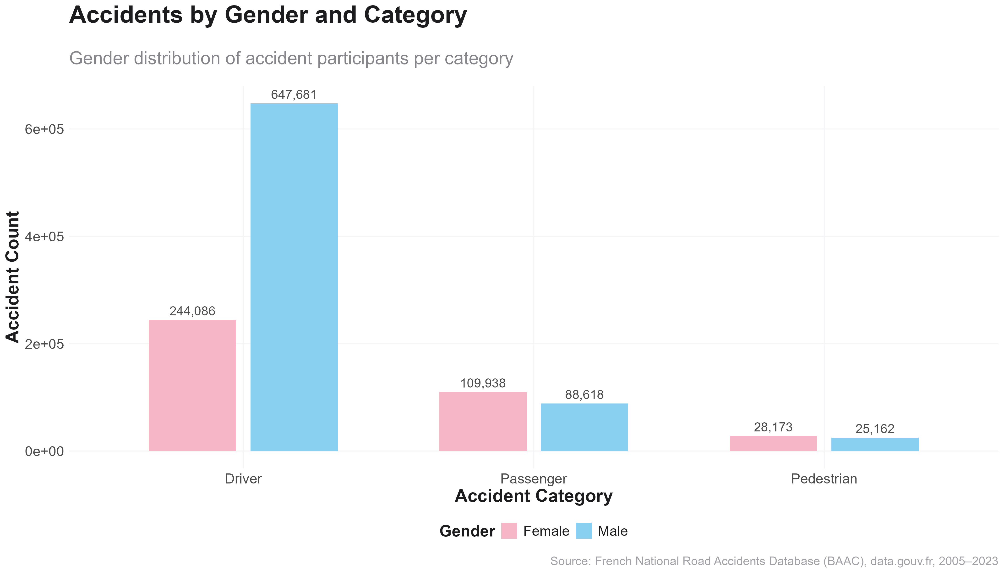
Demographic Risk Profiles
Who is most involved in accidents?
“Men are significantly overrepresented as drivers in accidents, while women are more likely to be passengers or pedestrians.
The majority of road accident drivers are male, whereas women appear more frequently as passengers. Pedestrian accident involvement is nearly balanced across genders.
Among drivers, male involvement (647,681) is nearly 2.7× higher than that of females (244,086), suggesting riskier driving behavior or higher vehicle usage by men.
In contrast, for passengers, females slightly outnumber males: 109,938 vs. 88,618.
Pedestrian counts are roughly equal across genders: 28,173 (F) vs. 25,162 (M), implying no significant gender difference in pedestrian vulnerability.
This distribution may reflect broader mobility and social behavior patterns:
Men possibly drive more frequently or for longer distances.
Women may be more reliant on public transport, or often occupy non-driving roles in vehicles.
France on the Road: A Nation in Motion
Insights from Road Accidents (2009–2012)

Slide 18
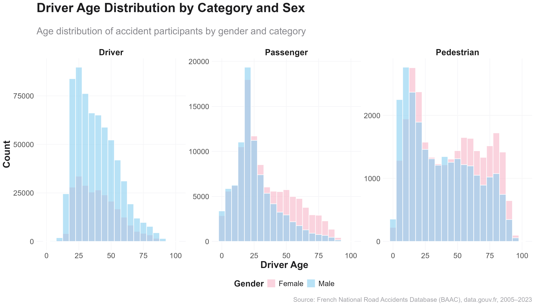
Demographic Risk Profiles
Who is most involved in accidents?
“Males dominate accident involvement across all roles, especially as drivers, while elderly female pedestrians show notable presence.
Accident involvement skews male across all categories. Elderly women are more represented among pedestrians than in any other group.
Drivers:
Male dominance across all ages, especially under 40
Female involvement drops with age, likely due to licensing patterns
Passengers:
More gender balance overall
Women slightly more represented in middle to older ages
Pedestrians:
Near gender parity
Elderly women (65–85+) overrepresented, reflecting greater exposure and vulnerability
France on the Road: A Nation in Motion
Insights from Road Accidents (2009–2012)

Slide 19
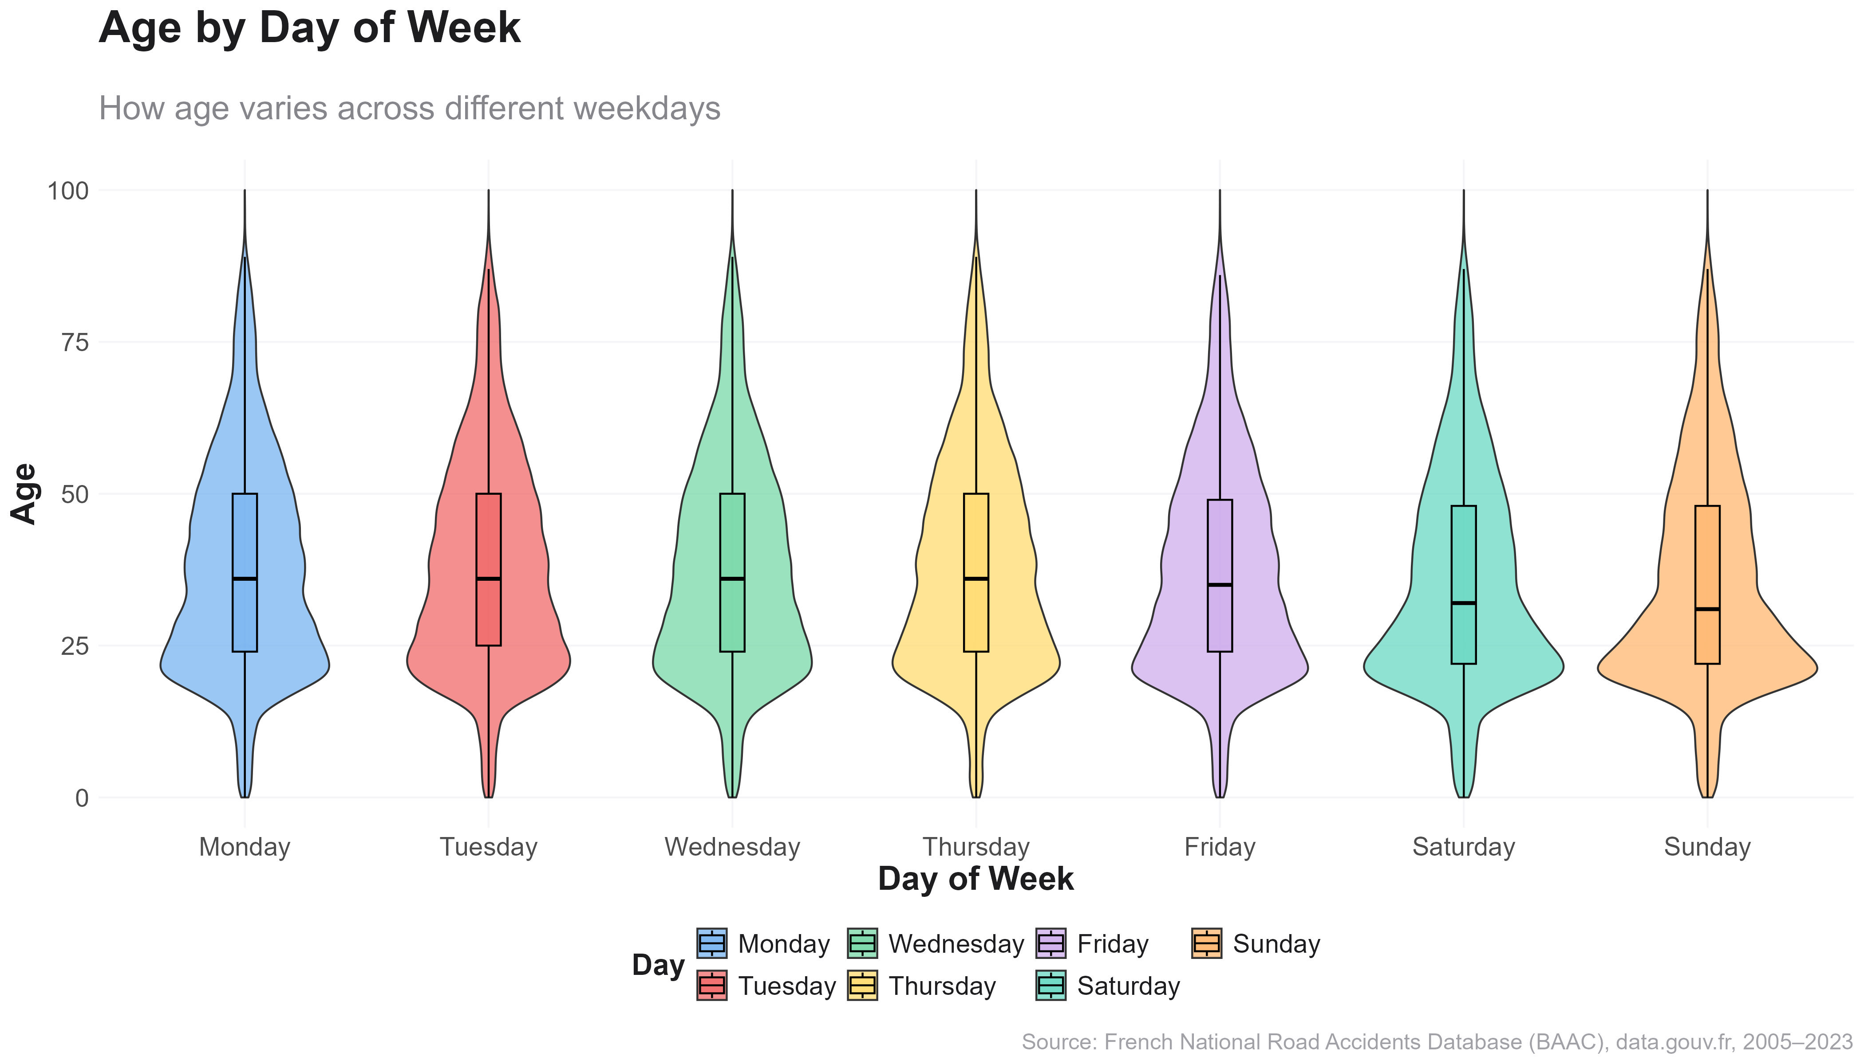
Demographic Risk Profiles
Who is most involved in accidents?
“Younger drivers are consistently overrepresented across all weekdays, with minor weekend variation.”
Young drivers (age 20–35) are the dominant group in accidents across every weekday.
Across all days, the median age is centered around 30.
There's little difference in median or spread between weekdays and weekends.
Slightly younger profiles appear on weekends (Saturday and Sunday), possibly due to leisure driving or nightlife.
France on the Road: A Nation in Motion
Insights from Road Accidents (2009–2012)

Slide 20
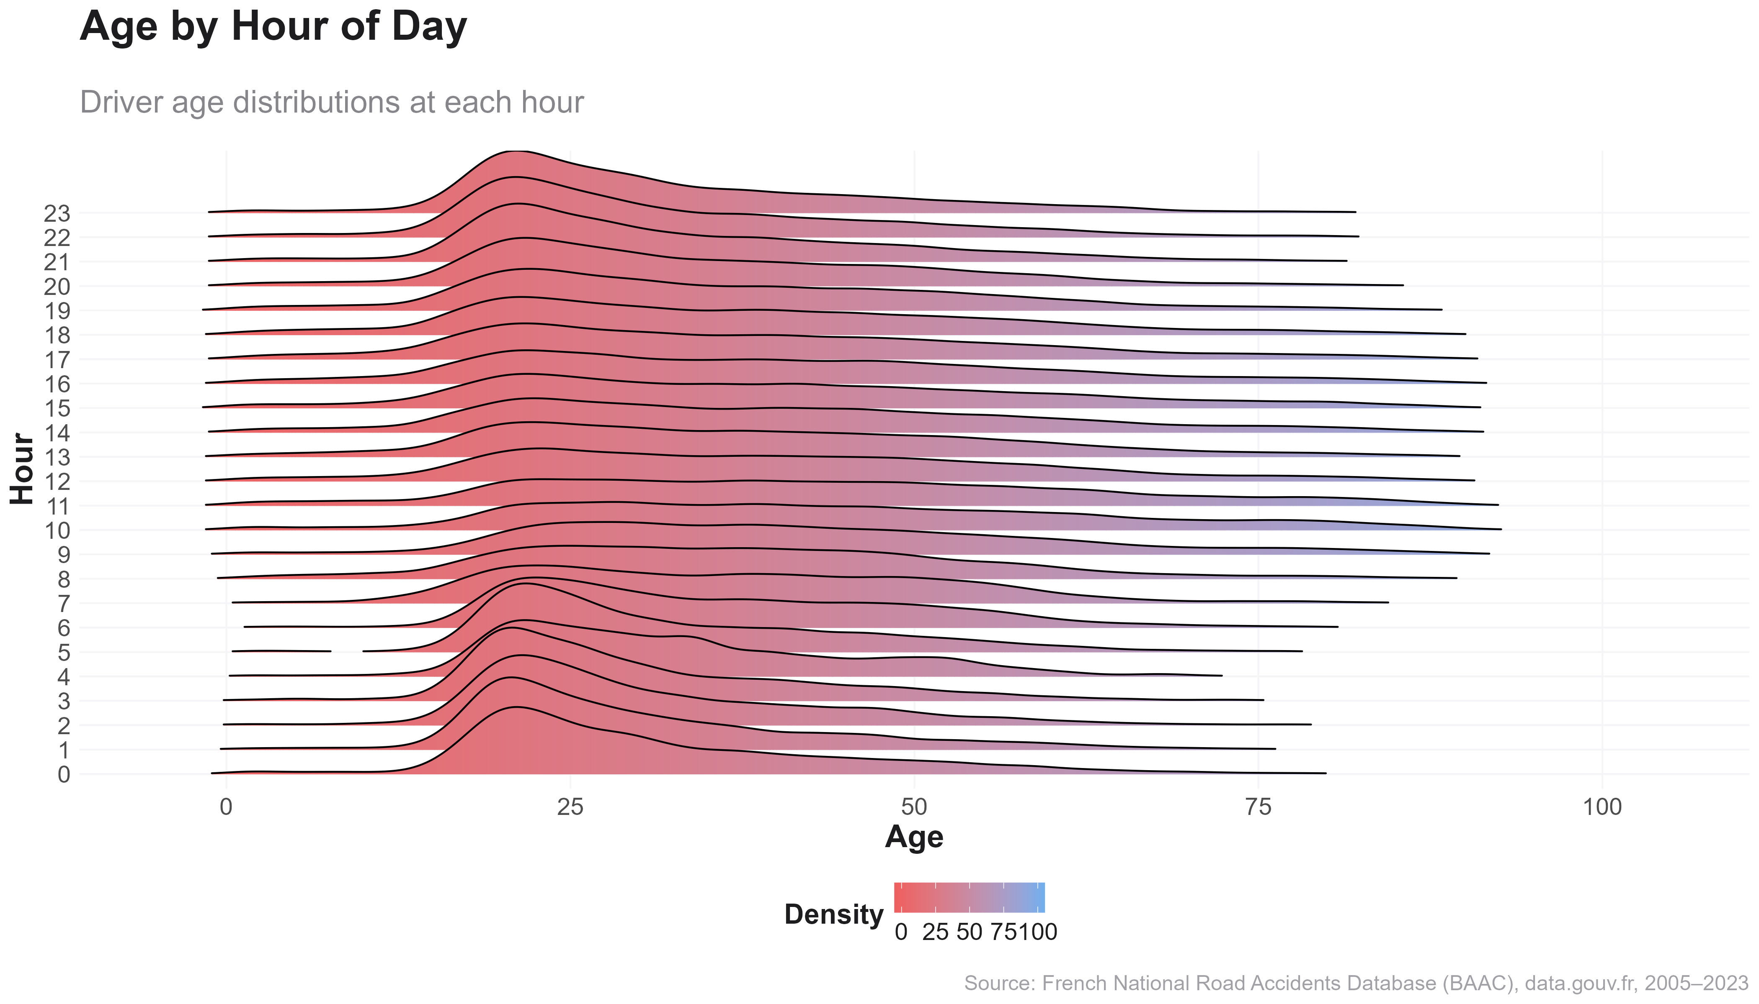
Demographic Risk Profiles
Who is most involved in accidents?
“Accident-prone hours vary by age — but young drivers dominate
nearly all times.”
Younger drivers (under 35) are the most common across all hours, with peak densities in early morning and afternoon.
Younger age bands (20–35) dominate across the full day.
Notably, their presence peaks around 08:00 and again at 17:00–18:00, matching earlier rush-hour peaks
Older drivers (>60) appear more evenly and modestly throughout the day.
Young drivers are more exposed (more driving hours) or possibly more vulnerable (risk-taking behaviors)
France on the Road: A Nation in Motion
Insights from Road Accidents (2009–2012)

Slide 21
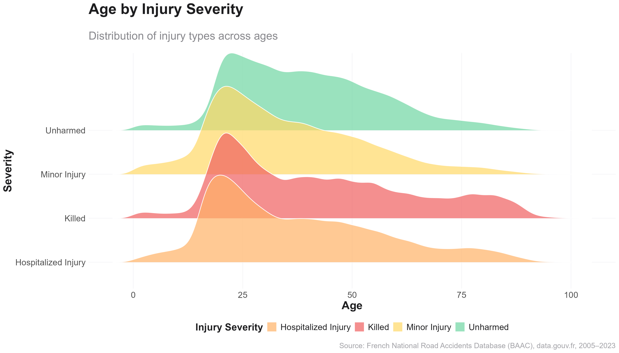
Demographic Risk Profiles
Who is most involved in accidents?
“Older drivers are more likely to die or be hospitalized in accidents — younger ones more often escape unharmed.”
Injury severity correlates with age: fatal and serious injuries rise with age, while minor or no injuries are more frequent among the young.
Unharmed and minor injury peaks: age 20–35
Hospitalizations and fatalities: shift sharply right, peaking at 60+
Older drivers are more vulnerable to trauma
Young drivers may crash more but survive more often
Could reflect physical fragility, reaction time, or medical recovery issues
France on the Road: A Nation in Motion
Insights from Road Accidents (2009–2012)

Slide 22
Environmental Conditions
Do weather, light, and road surface play a role?
France on the Road: A Nation in Motion
Insights from Road Accidents (2009–2012)
Notes:
NIKOS

Slide 23
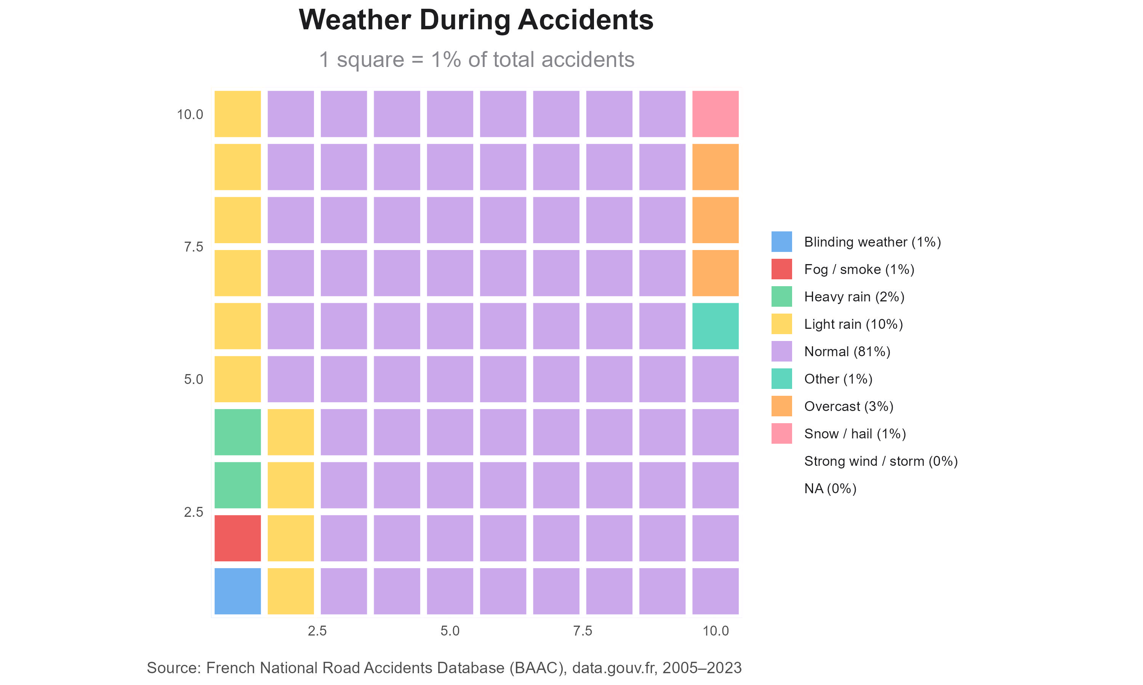
Environmental Conditions
Do weather, light, and road surface play a role?
“Most accidents occur in normal weather, but poor conditions still account for 19% of incidents.”
81% of accidents occur in good weather, but light rain, fog, and snow contribute to a sizable share.
Normal weather dominates (81%) — confirming that driver behavior, not weather, is often the key factor.
Still, light rain (10%), overcast (3%), and heavy rain (2%) contribute to a meaningful portion of accidents.
Severe weather (snow, hail, fog, blinding sun) together make up ~5%.
France on the Road: A Nation in Motion
Insights from Road Accidents (2009–2012)

Slide 24
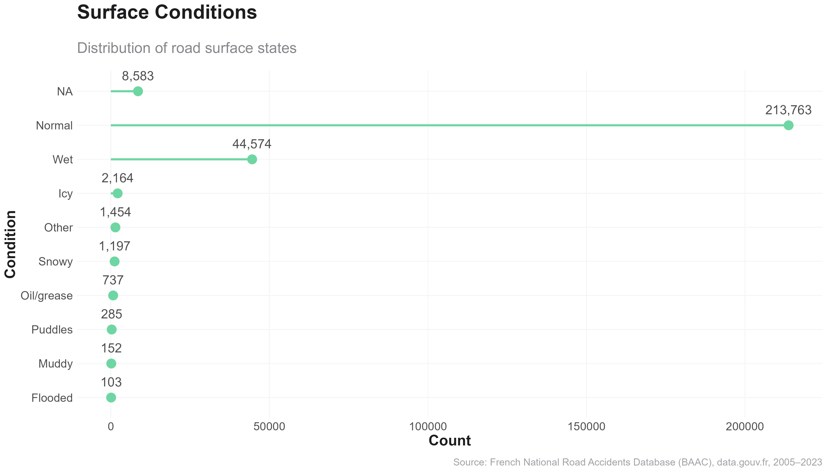
Environmental Conditions
Do weather, light, and road surface play a role?
“Wet and hazardous surfaces increase accident risk, but most crashes still occur on dry roads.”
Most accidents occur on normal road surfaces, but wet, icy, and snowy conditions, while rarer, pose increased safety risks.
Over 213,000 accidents occurred on dry roads, confirming again that driver behavior is the primary contributor to accidents.
However, wet surfaces (44,574 cases) account for 17% of known conditions, and icy roads contributed over 2,000 incidents.
Small but non-negligible risks are visible for snowy, greasy, and flooded roads — these must be prioritized during winter readiness campaigns.
France on the Road: A Nation in Motion
Insights from Road Accidents (2009–2012)

Slide 25
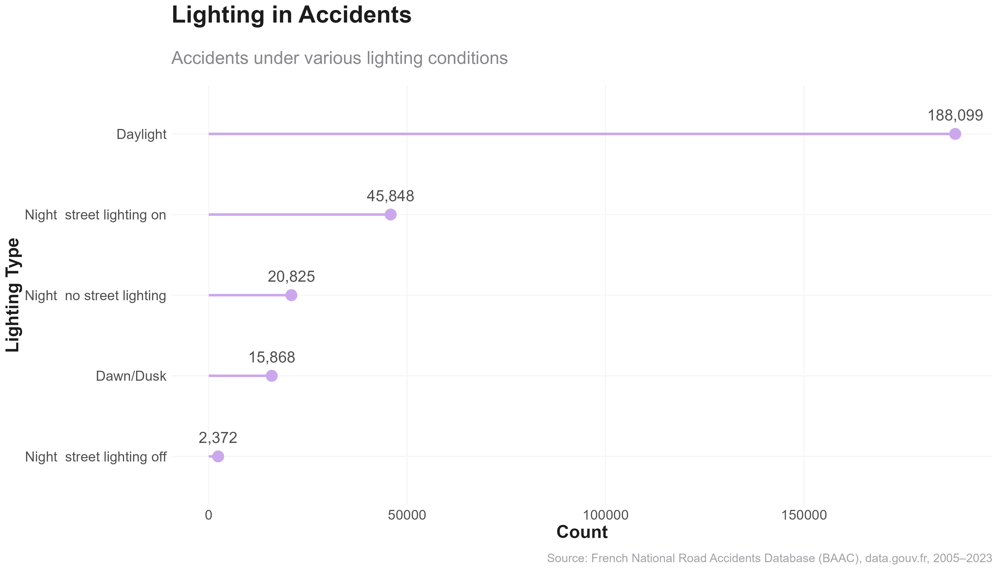
Environmental Conditions
Do weather, light, and road surface play a role?
“Lighting levels impact visibility and risk, especially at night.”
Most accidents occur in daylight, but poor lighting at night still contributes to tens of thousands of collisions.
Nearly 188,099 accidents occurred in daylight, simply due to high traffic volume.
However, accidents in poorly lit or unlit night conditions (over 20,000 cases) show elevated risks, particularly in rural zones or faulty urban lighting.
Street lighting helps mitigate risk — e.g., night accidents with lights on (45,848) are twice as common as those with no lighting (20,825) — but still hazardous.
France on the Road: A Nation in Motion
Insights from Road Accidents (2009–2012)

Slide 26
Injury Severity &
Health Outcomes
How severe are the consequences of accidents?
France on the Road: A Nation in Motion
Insights from Road Accidents (2009–2012)
Notes:
NIKOS

Slide 27
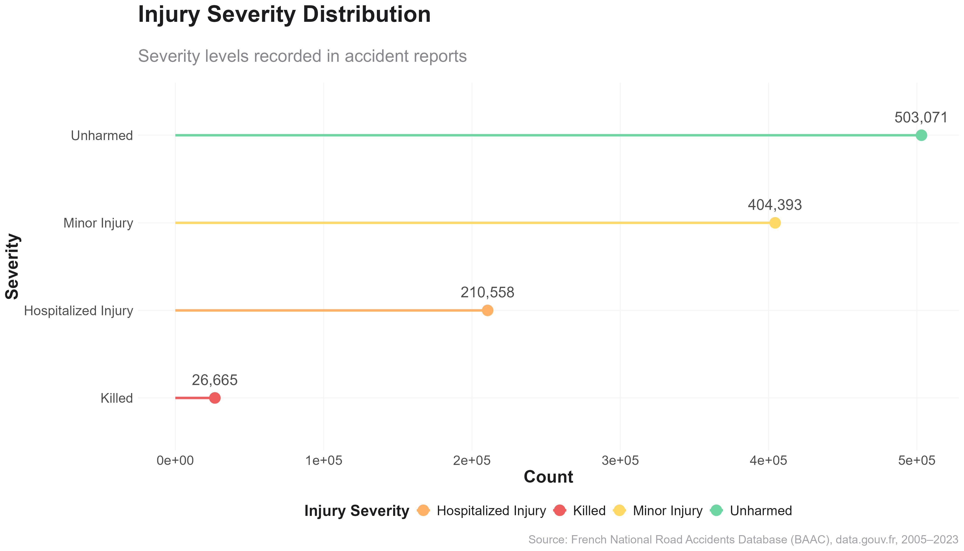
Injury Severity & Health Outcomes
How severe are the consequences of accidents?
“Most accident victims are unharmed or lightly injured — but over 26,000 fatalities highlight the human cost.”
Half a million accident participants were uninjured, yet over 210,000 were hospitalized and more than 26,000 killed.
503,071 unharmed individuals – suggests that many incidents are low-impact or benefit from safety features (seatbelts, airbags)
404,393 minor injuries – requiring first aid or outpatient care
210,558 hospitalizations – often indicating life-threatening or long-term injuries
26,665 fatalities – representing the ultimate consequence of road risk
France on the Road: A Nation in Motion
Insights from Road Accidents (2009–2012)

Slide 28
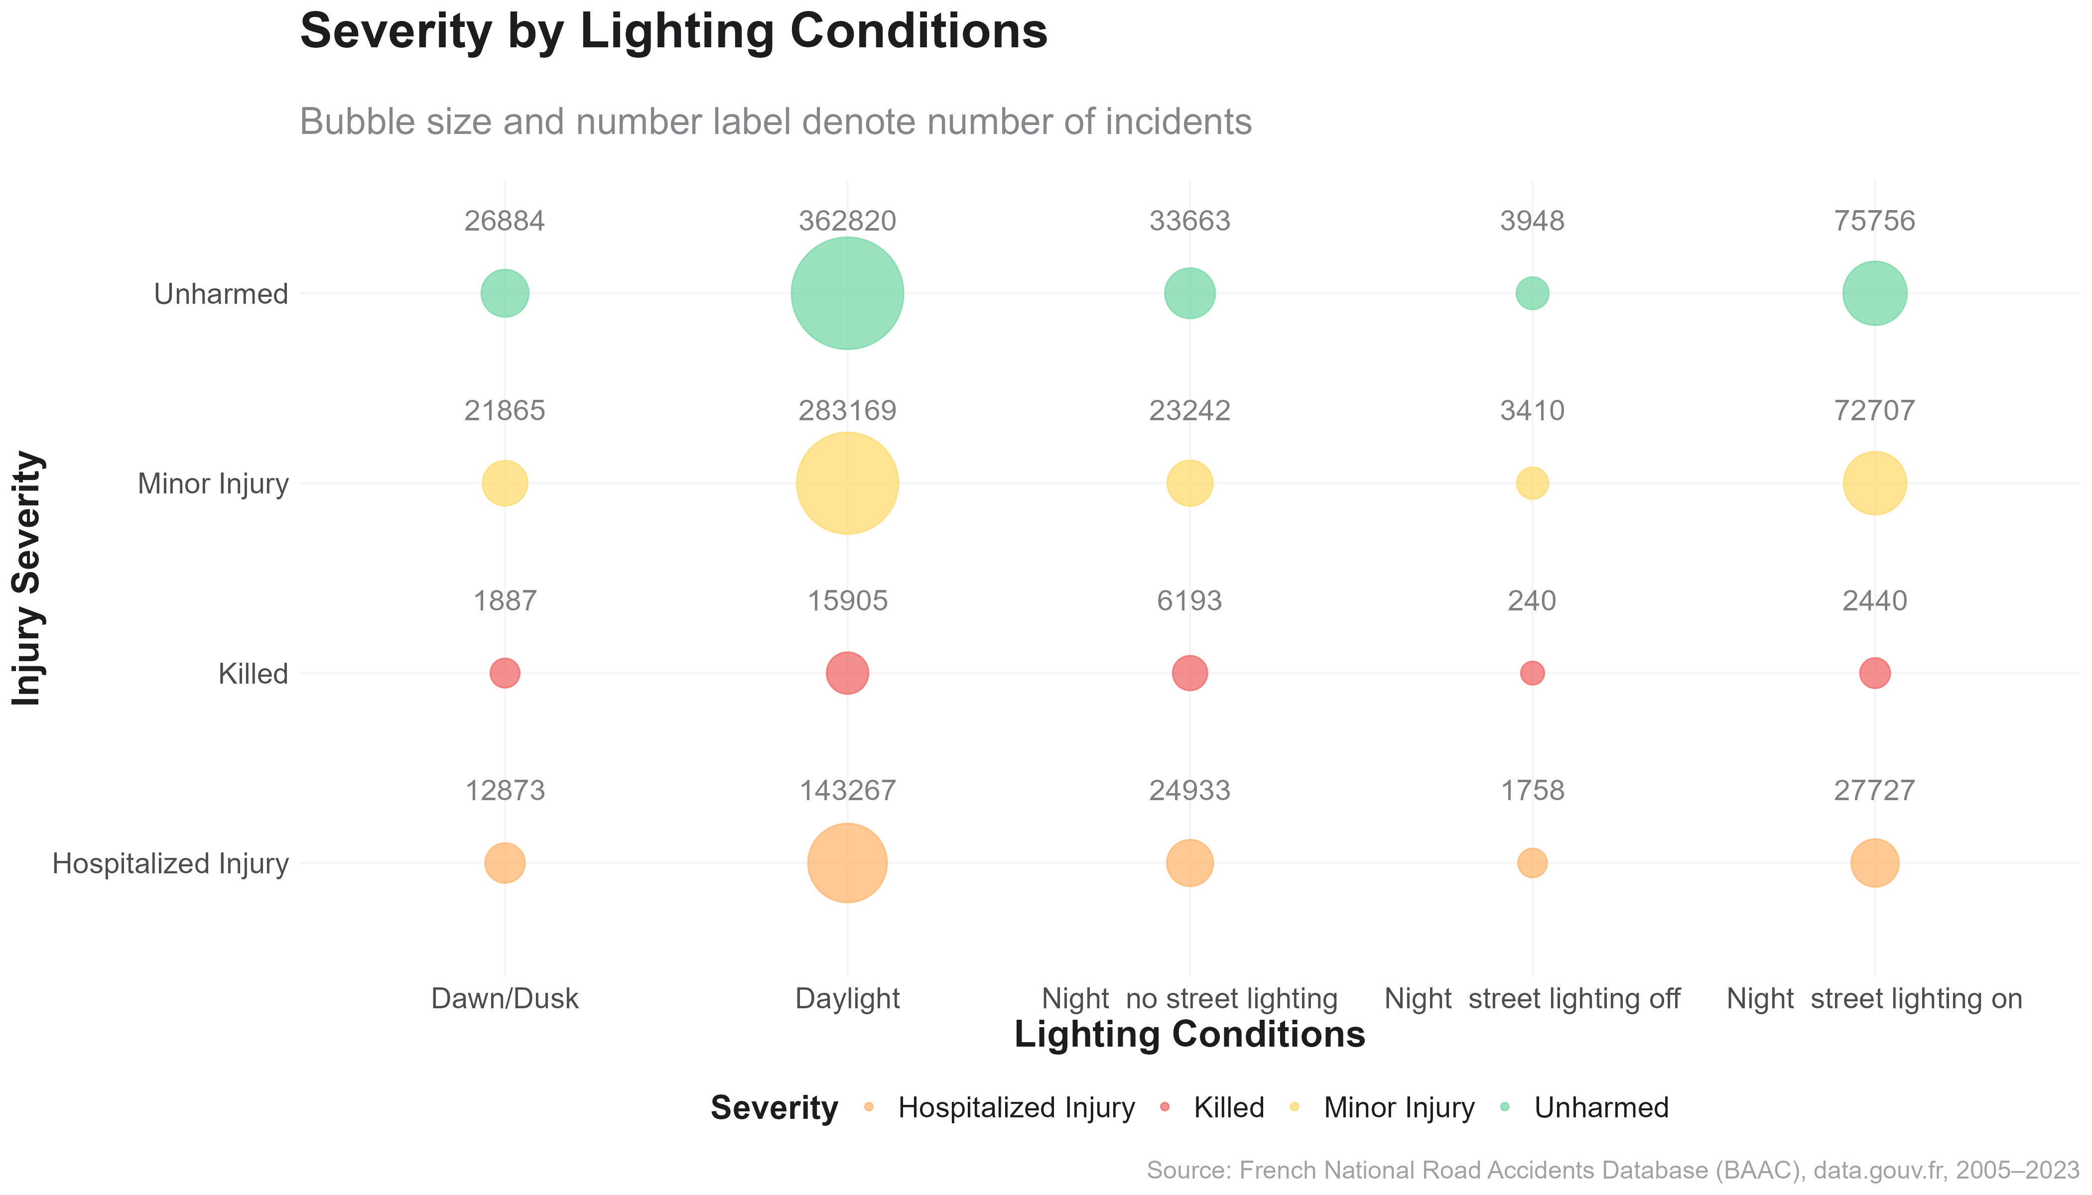
Injury Severity & Health Outcomes
How severe are the consequences of accidents?
“Most accidents happen in daylight, but lighting conditions at night dramatically increase severity risk.”
Daylight sees the most accidents overall, but night conditions — especially without street lighting — carry a significantly higher risk of death or serious injury.
Under daylight, we see 805,161 total incidents, with 15,905 deaths →Fatality rate: ~1.97 per 1000 accidents
Hospitalization rate: ~17.78%
Under "night – no street lighting", we have 88,031 incidents with 6,193 deaths →
Fatality rate: ~70.36 per 1000 accidents
Hospitalization rate: ~28.32%
“~35x more likely to die in an accident occurring at night without lighting than during the day.”
Even with street lighting, night accidents are riskier (~13.7 deaths per 1,000). Lighting doesn’t reduce accident counts, but it clearly reduces severity.
France on the Road: A Nation in Motion
Insights from Road Accidents (2009–2012)

Slide 29
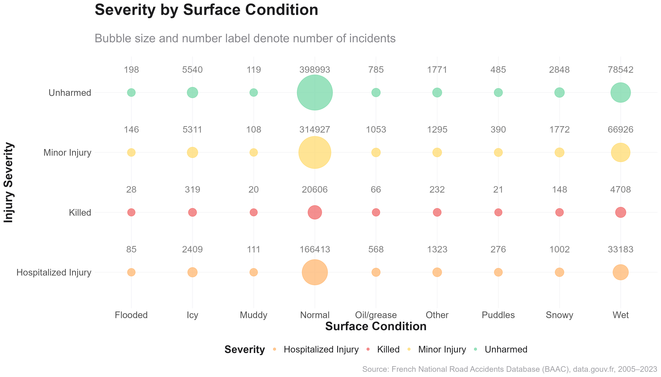
Injury Severity & Health Outcomes
How severe are the consequences of accidents?
“Hazardous road surfaces—though less frequent—carry a disproportionately high risk of death and serious injury in traffic accidents.”
Dangerous surfaces such as wet, icy, and flooded roads show significantly higher ratios of fatalities and hospitalizations compared to normal roads.
“Although most accidents (nearly 1.4 million) occur on normal surfaces, the risk per incident changes dramatically under hazardous conditions”
Wet roads, with ~183,000 accidents, show a fatality ratio of 25.67 per 1,000 – almost 2x higher than on normal roads.
Icy roads, while accounting for just ~15,500 cases, result in over 20 deaths per 1,000 incidents, a marked increase in severity.
The most extreme example is flooded roads, which—despite being rare (~427 cases)—have a fatality ratio of 65.6 per 1,000, nearly 5x higher than average.
This has strong implications for road safety planning
France on the Road: A Nation in Motion
Insights from Road Accidents (2009–2012)

Slide 30
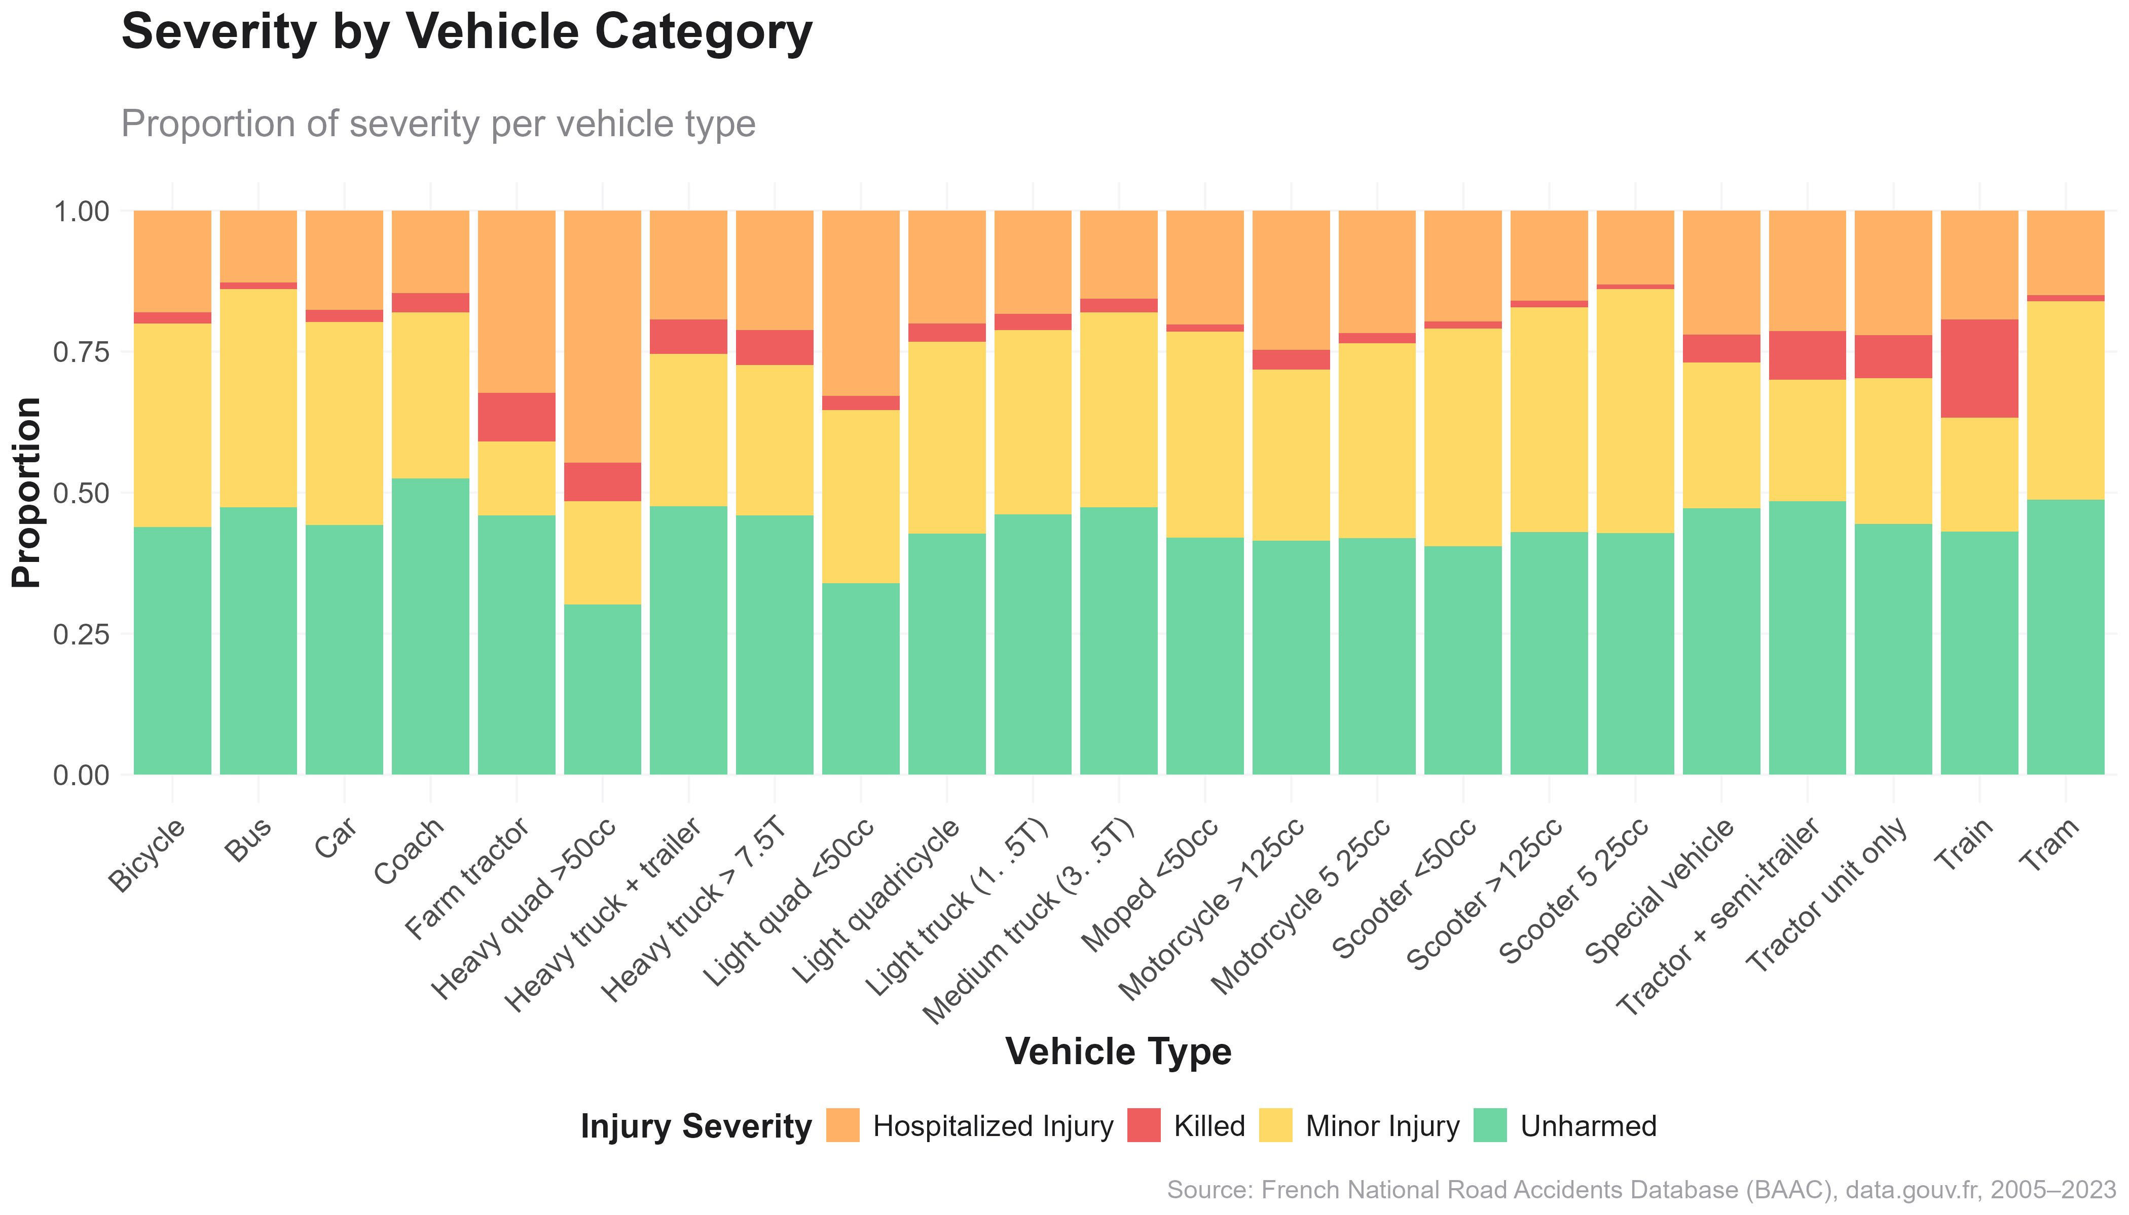
Injury Severity & Health Outcomes
How severe are the consequences of accidents?
“Motorcycles and heavy vehicles show a higher share of severe outcomes — cars offer better protection.”
Two-wheelers and trucks have a higher proportion of deaths and hospitalizations; cars and buses skew toward lower injury rates.
Motorcycles and scooters show the most severe outcomes per capita
Trucks also have a disproportionate share of serious injuries
Cars show more “unharmed” outcomes — suggesting structural safety benefits (e.g., airbags, crash zones)
Buses and trams record the lowest severity, likely due to low speeds and professional drivers
France on the Road: A Nation in Motion
Insights from Road Accidents (2009–2012)

Slide 31
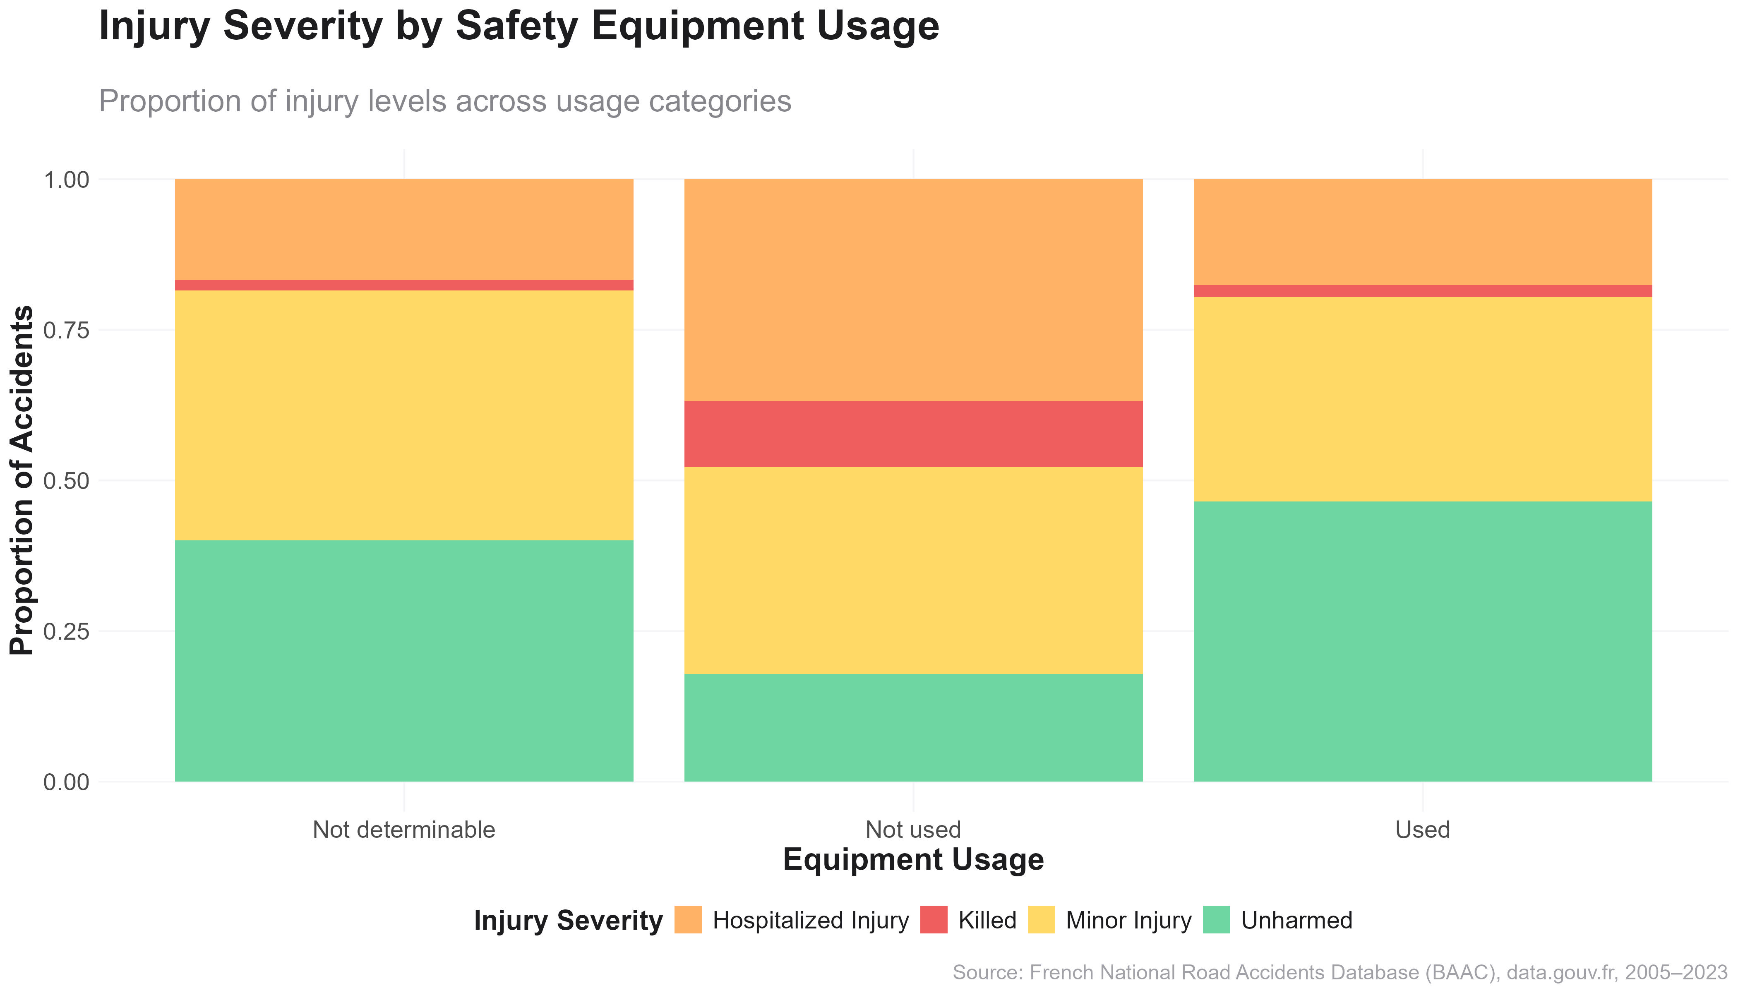
Injury Severity & Health Outcomes
How severe are the consequences of accidents?
“Not using safety equipment significantly increases the likelihood of severe or fatal injuries.”
Injury severity is clearly affected by safety equipment usage. Non-usage is linked to a much higher proportion of deaths and hospitalizations.
Used equipment: nearly 45% unharmed, with low fatality and hospitalization rates
Not used: dramatically higher proportion of serious and fatal injuries
Unknown usage shows an ambiguous middle ground — underscores the need for better data collection
Key conclusion:
Equipment like seatbelts and helmets drastically reduces harm
Final confirmation of the “human behavior > environment” thesis
France on the Road: A Nation in Motion
Insights from Road Accidents (2009–2012)

Slide 32
Behavior & Exposure
Why, how, and with what do people travel?
France on the Road: A Nation in Motion
Insights from Road Accidents (2009–2012)
Notes:
NIKOS

Slide 33
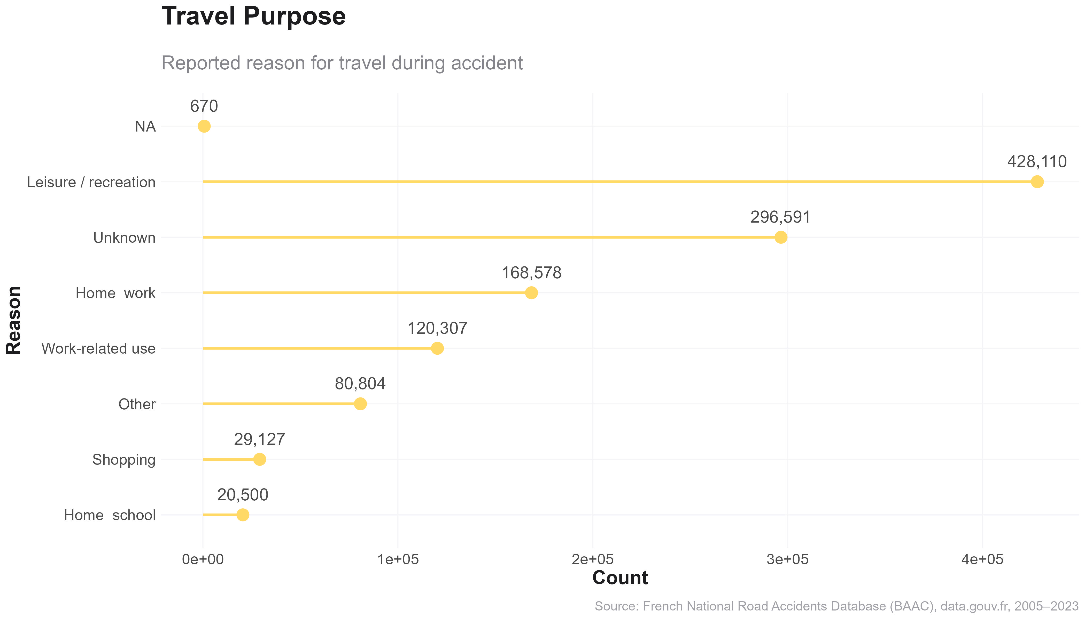
Behavior & Exposure
Why, how, and with what do people travel?
“Leisure travel accounts for the most accidents — exceeding work, school, or errand-related driving.”
Leisure-related travel leads all other purposes in accident volume, with over 428,000 cases — nearly 3.5× higher than commuting.
428,110 leisure/recreation trips involved in accidents — the highest by far
Work commutes (120,307) and on-the-job driving (81,000+) follow
Other common purposes:
o Errands/shopping (52,000)
o School-related (20,000+)
Nearly 300,000 cases had unknown travel reasons, which reflects a data quality challenge
Leisure travel often happens on weekends, at night, and on longer routes — aligning with earlier time and behavior patterns
France on the Road: A Nation in Motion
Insights from Road Accidents (2009–2012)
Notes:
NIKOS

Slide 34
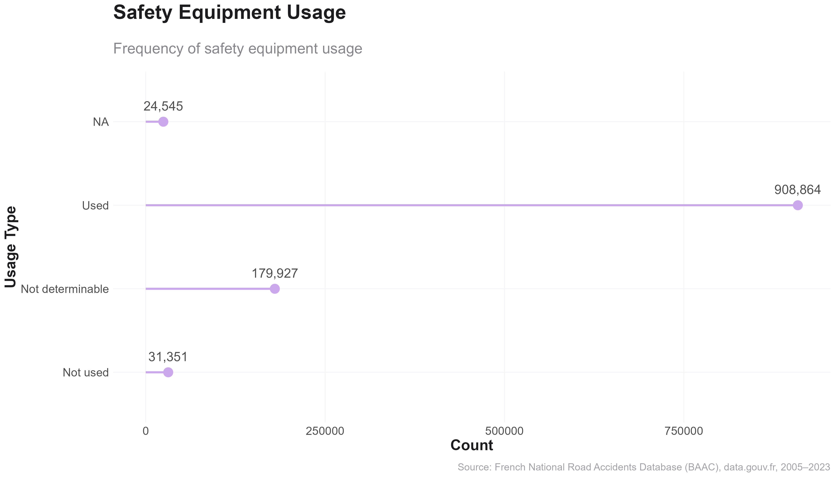
Behavior & Exposure
Why, how, and with what do people travel?
“Most accident participants wore safety gear — but tens of thousands still didn’t.”
Over 900,000 accident participants reported using safety equipment; however, more than 31,000 did not, and 180,000 cases were undetermined.
France on the Road: A Nation in Motion
Insights from Road Accidents (2009–2012)

Slide 35
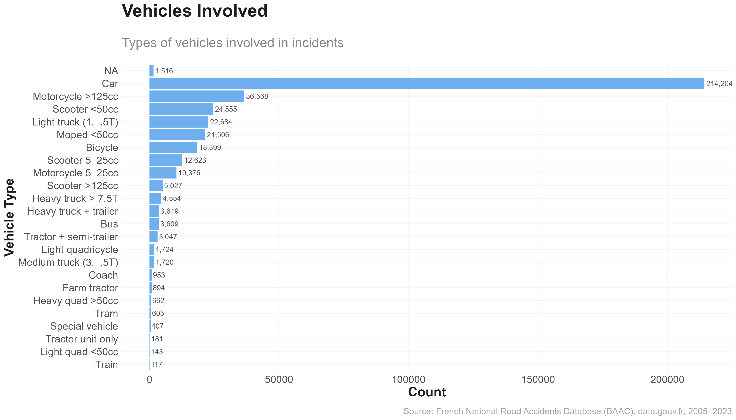
Behavior & Exposure
Why, how, and with what do people travel?
“Cars are the most involved vehicle type by far, followed by two-wheelers and light trucks.”
With over 214.204 cars involved, this chart confirms their dominance in road traffic. Two-wheelers follow with high accident involvement.
Cars (214.204) dominate due to volume and availability
Scooters, mopeds, and motorcycles come next — confirming their exposure and vulnerability
Light and heavy trucks follow, important due to mass and momentum
Bicycles, buses, and agricultural vehicles are present in smaller but notable quantities
France on the Road: A Nation in Motion
Insights from Road Accidents (2009–2012)

Slide 36
Behavior & Exposure
Why, how, and with what do people travel?
“Not using safety equipment significantly increases the likelihood of severe or fatal injuries.”
Injury severity is clearly affected by safety equipment usage. Non-usage is linked to a much higher proportion of deaths and hospitalizations.
Used equipment: nearly 45% unharmed, with low fatality and hospitalization rates
Not used: dramatically higher proportion of serious and fatal injuries
Unknown usage shows an ambiguous middle ground — underscores the need for better data collection
Equipment like seatbelts and helmets drastically reduce harm
Final confirmation of the “human behavior > environment” thesis
France on the Road: A Nation in Motion
Insights from Road Accidents (2009–2012)

Slide 37
Tableau Dashboard
Interactive Approach
Explore how time, location, vehicles, and behavior shape road accident risks and outcomes.
France on the Road: A Nation in Motion
Insights from Road Accidents (2009–2012)
Notes:
GIANNIS

Slide 38
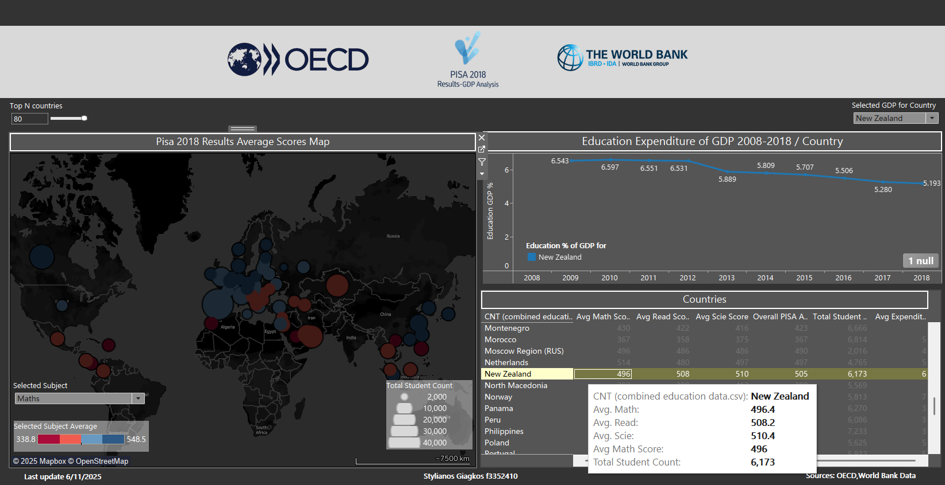
Tableau Dashboard Interactive Approach
Explore how time, location, vehicles, and behavior shape road accident risks and outcomes.
Dashboard Purpose
To explore the relationship between educational performance (PISA 2018 scores) and national education expenditure (% of GDP) across countries, using dynamic visualizations.
Example Insight
New Zealand's education expenditure dropped from ~6.6% (2010) to ~5.2% (2018), yet it maintains high average scores (~500+), suggesting spending efficiency.
Dashboard Components
1. World Map of PISA Math Scores
Bubble Size: Total number of students per country.
Bubble Color: Average Math score
(red = low, blue = high).
Slider: Filter top N performing countries.
Subject Selector: Switch between Math, Reading, or Science.
2. Line Chart: Education Spending Over Time
Shows % of GDP spent on education (2008–2018) for selected country (e.g., New Zealand).
Reflects spending trends and potential correlation with performance.
3. Data Table: Country Metrics
Detailed metrics by country:
Average scores (Math, Reading, Science)
Overall PISA score
Total student count
Average GDP education expenditure
France on the Road: A Nation in Motion
Insights from Road Accidents (2009–2012)

Slide 39
Conclusions and
Policy Recommendations
France on the Road: A Nation in Motion
Insights from Road Accidents (2009–2012)
Notes:
NIKOS

Slide 40





Conclusions and Policy Recommendations
Summary of Findings
Accidents are predictable in time and space.
Peaks occur on Fridays, during rush hours (17:00–19:00), and in October — showing strong temporal regularity.
Urban areas concentrate the most incidents, yet rural and departmental roads also pose serious risks.
Environmental factors are not the main cause.
Over 80% of accidents occur in good weather, daylight, and on dry roads — pointing to human behavior as the leading risk driver.
Leisure-related and non-essential trips carry disproportionate risk.
Recreational travel far outweighs commuting in accident counts — especially during holidays and weekends.
Young drivers, especially males, are most frequently involved.
The majority of accident participants are under 35 and male, with the highest activity seen during peak traffic times and weekends.
Injury severity is heavily influenced by age, behavior, and vehicle type.
Older individuals face more severe outcomes.
Two-wheeler users and those without protective equipment are disproportionately hospitalized or killed.
France on the Road: A Nation in Motion
Insights from Road Accidents (2009–2012)
Notes:
NIKOS

Slide 41





Conclusions and Policy Recommendations
Toward a Safer and Smarter Road Network in France
1. Demographics & Driver Behavior
Expand targeted education for young drivers, focusing on emotional control, fatigue, and risk awareness.
Promote senior driver health screening to reduce fatality risk in aging populations.
2. Time-Based Enforcement & Awareness
Deploy traffic enforcement such as speed checks and alcohol tests during Friday evenings and holiday weekends.
Launch seasonal campaigns before high-risk months like September and October, and around national holidays.
3. Urban Planning & Infrastructure
Ensure adequate street lighting, especially in rural areas or where nighttime accidents are common.
Encourage local authorities to enhance pedestrian and cyclist safety on municipal roads.
4. Vehicle & Equipment Regulation
Mandate and monitor helmet and seatbelt use, with stricter penalties for non-compliance.
Promote the use of Advanced Driver-Assistance Systems (ADAS), especially in motorcycles and trucks.
5. Leverage Data for Policy
Improve accident report forms to better capture behavioral and safety equipment usage.
Fund regional traffic safety observatories to monitor and respond to emerging accident trends.
France on the Road: A Nation in Motion
Insights from Road Accidents (2009–2012)
Notes:
STELIOS

Slide 42
Thank You!
France on the Road: A Nation in Motion
Insights from Road Accidents (2009–2012)

